Slide 1
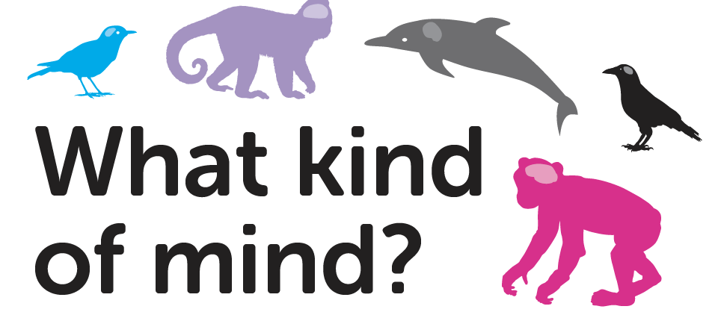
Lesson 5
School of Psychology and Neuroscience, and Department of Philosophy,
University of St Andrews

Slide 2
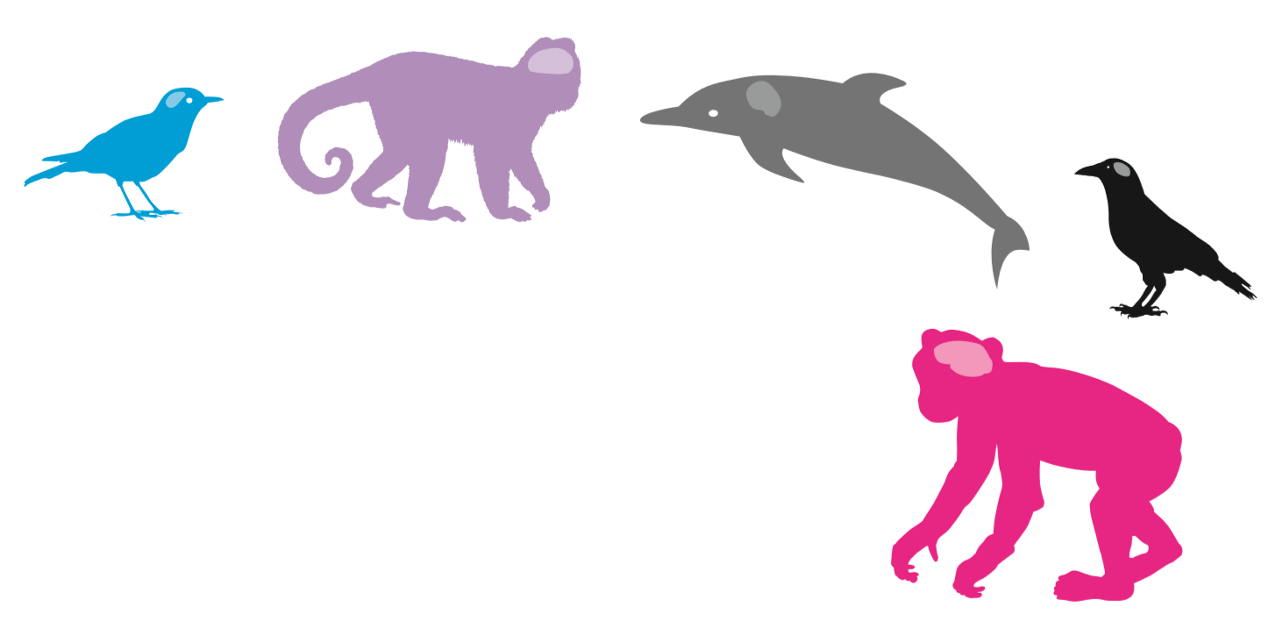
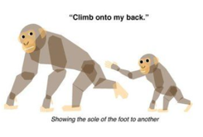
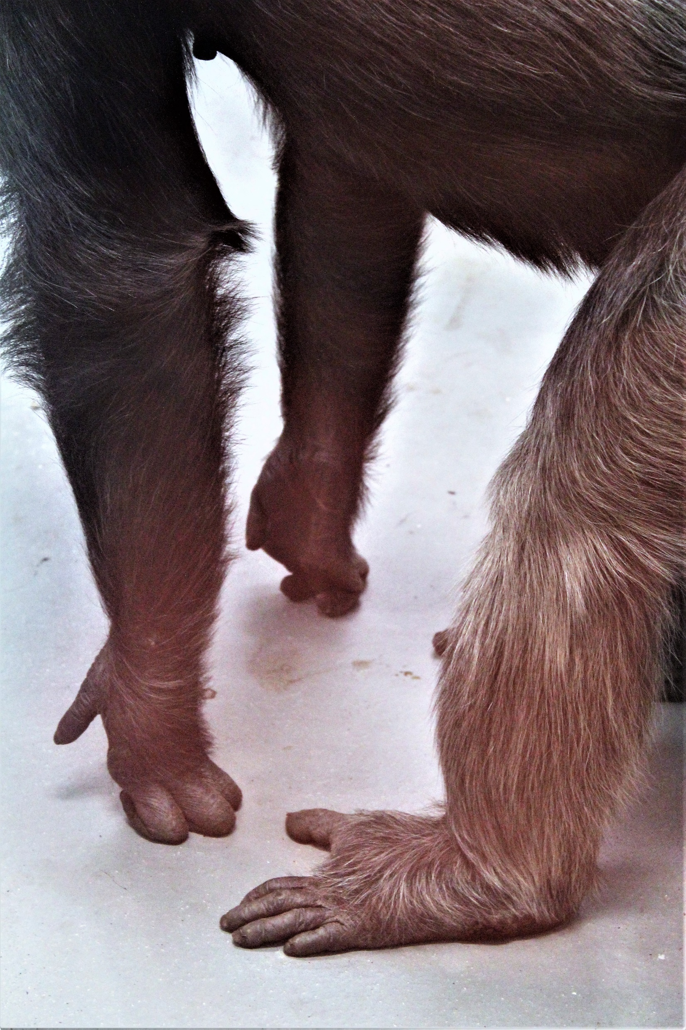
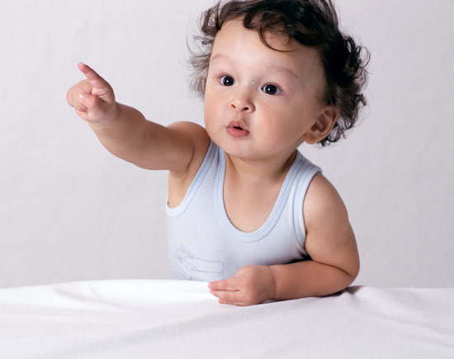
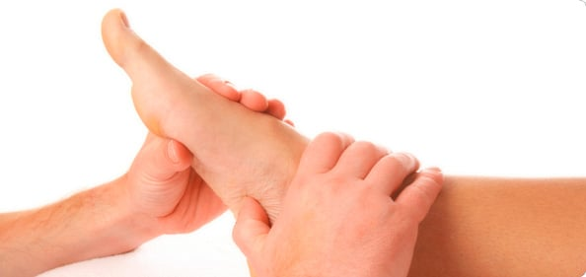
Last time we thought about:
Is chimpanzee communication like language?
Look at that!
Notes:
Instructions: Recap the main points of lesson 4 as follows:
Last time we thought about how chimpanzees are our closest living primate relatives. We thought about the similarities and difference in human and chimp hands, feet, faces and vocal apparatus. We then thought about what language is and whether chimps have a language in the way that humans understand this. We tried to communicate without using words. We watched a film about chimp communication and saw the gestures which they use and considered whether this was a language. We then made up our own chimp gestures and tried to use these to communicate different messages to each other.

Slide 3
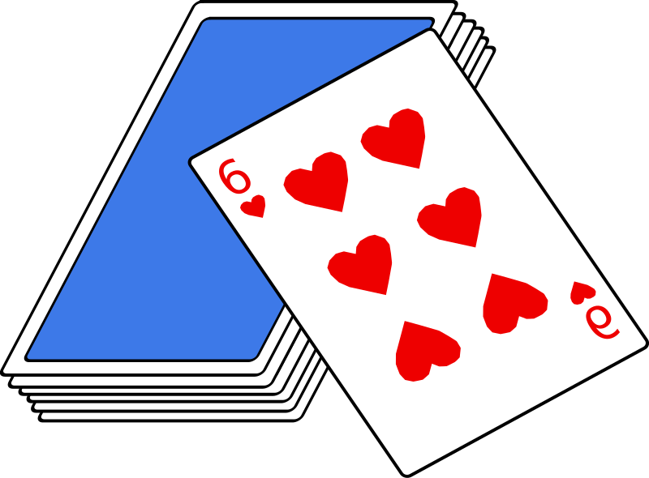
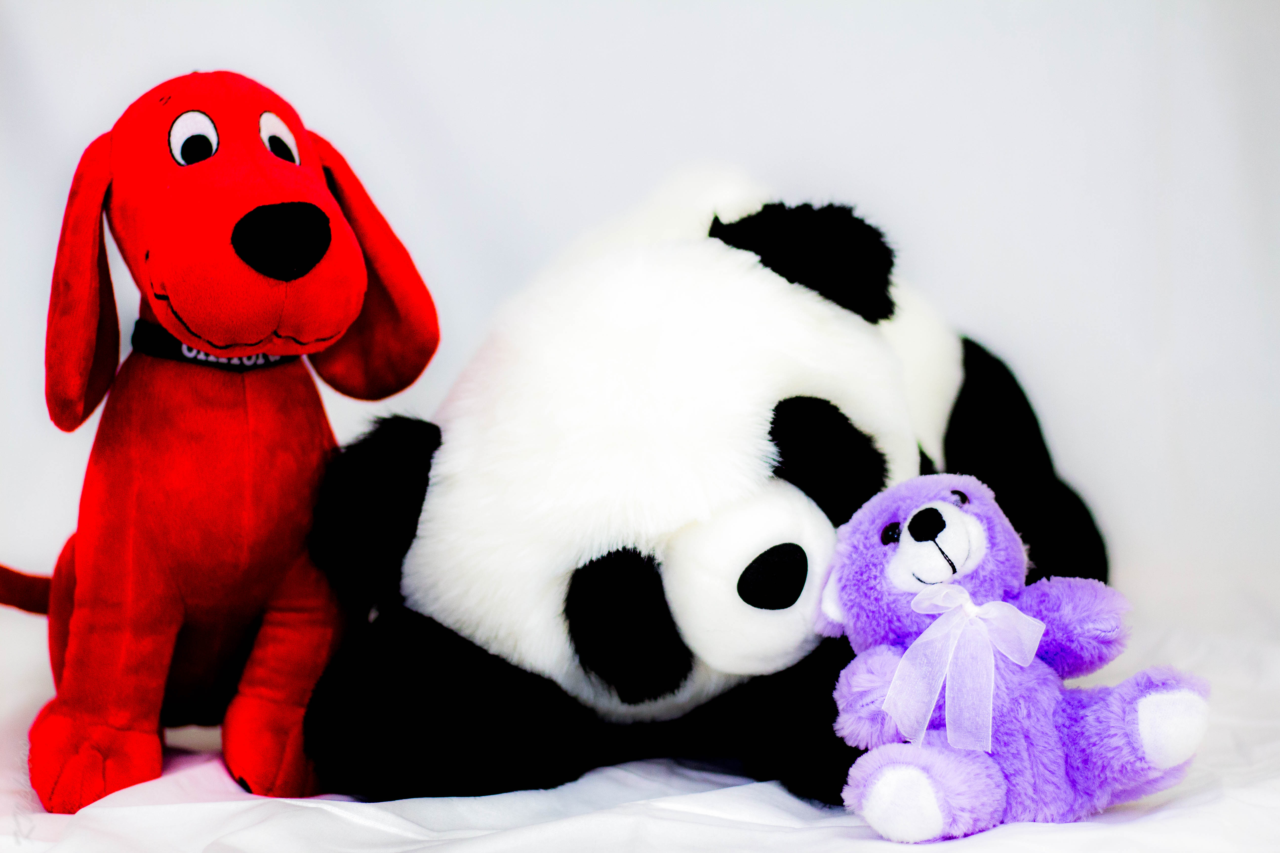
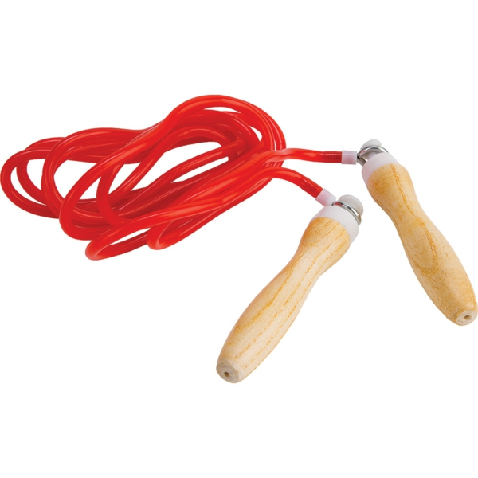
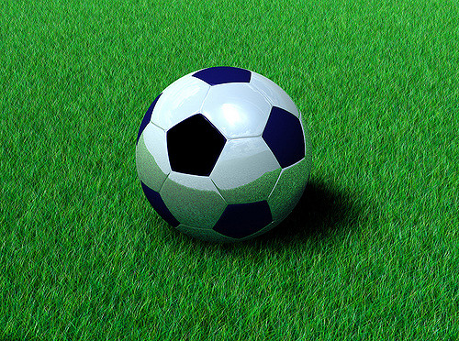
What is play?
Listen to the stories about the children
What do you think?
Give a reason for your answer.
Notes:
Using Slide 3 as a prompt, read the following short stories to the children and pose the accompanying questions. They are being asked to consider whether going through the motions of playing, that is playing without having fun, can be properly considered as playing. Philosophers can imagine scenarios where beings may go through the motions of playing but not have any fun. For example, animals play to learn survival skills and social interaction, but are they having fun when they are doing this? Do they need to have fun when they play? The emphasis here is on getting the children to think more deeply about what play may be and if fun is a necessary part of playing for humans and non-human animals.
Stories About Playing:
Kirsty
Once upon a time there was a girl named Kirsty. She lived in a normal house in a street where lots of children lived. She had made many friends on her street.
Her mother was always telling her to go out and spend time with the other children in their street. Kirsty did as her mother wanted, and each day went outside with her friends.
Kirsty and her friends chased each other; they jumped with a skipping rope; they kicked a football about; they made up stories with toy animals and they built things with construction sets. They tried board games and video games.
However, Kirsty did not enjoy this. She did not have fun. In fact, Kirsty never had fun at all when she did these things with her friends.
Do you think Kirsty was playing if she didn’t have fun?
Do we have to enjoy ourselves to play?
Sanjeev and his Mum
Sanjeev and his mum spent a lot of time together every day after school.
Sanjeev’s favourite game was Animal Snap. He had a special set of cards with a picture of an animal on each one. Some of the animals on the cards matched and when one of these was placed on top of another, someone had to shout, ‘Snap!’ and they would win all the cards in the pile. The person who managed to get all the cards was the winner. Sanjeev loved this game and to get all the cards.
Sanjeev’s mum did not like snap. She did not enjoy it at all and it was not fun for her. However, every day she would have several games of snap with Sanjeev. She smiled but she did not have fun.
Do you think that Sanjeev is playing?
Do you think that Sanjeev’s mum is playing?
Do we have to have fun when we play?

Slide 4
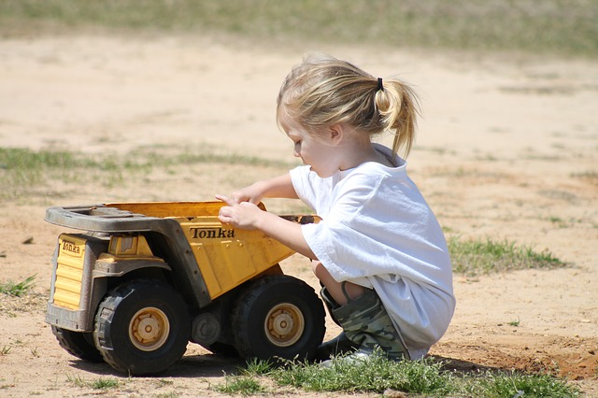
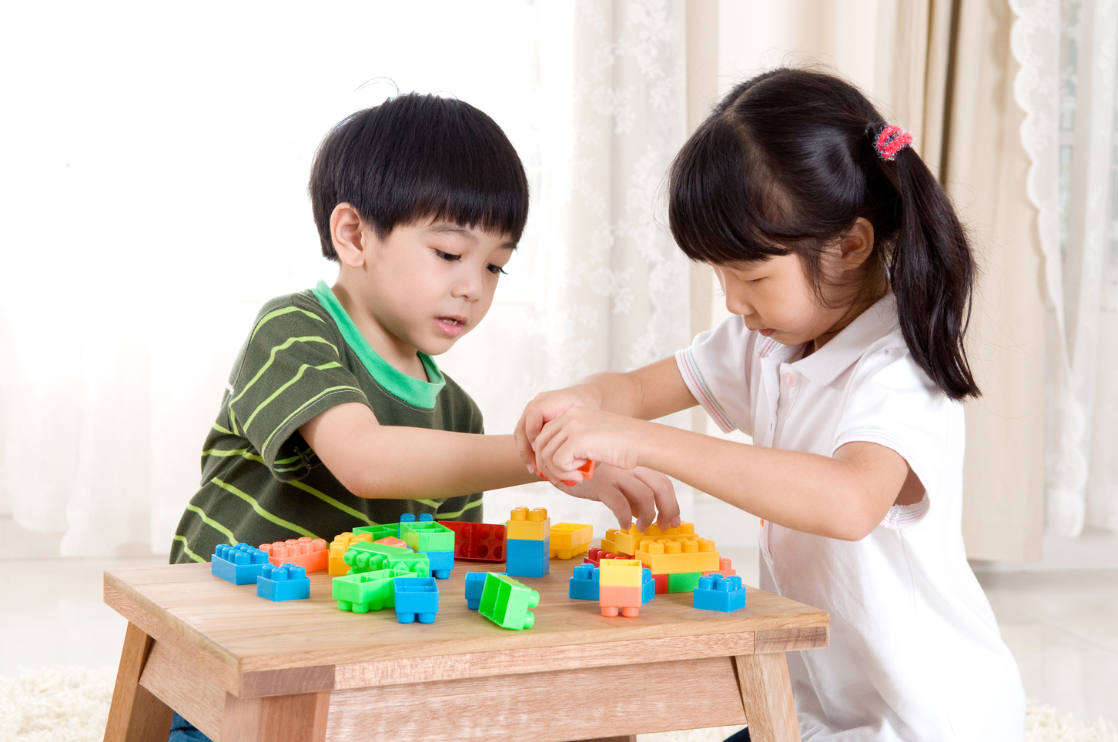
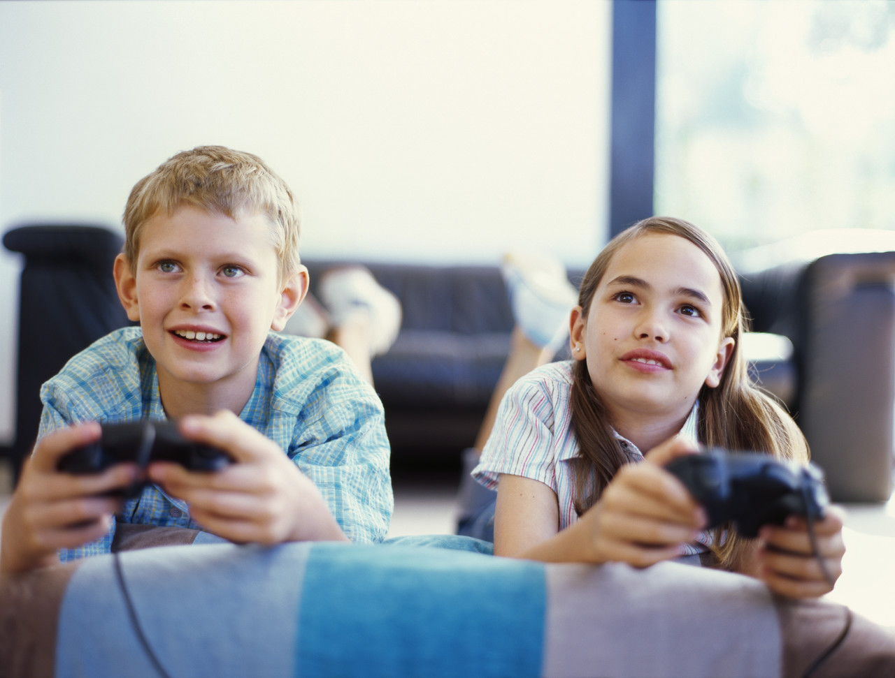
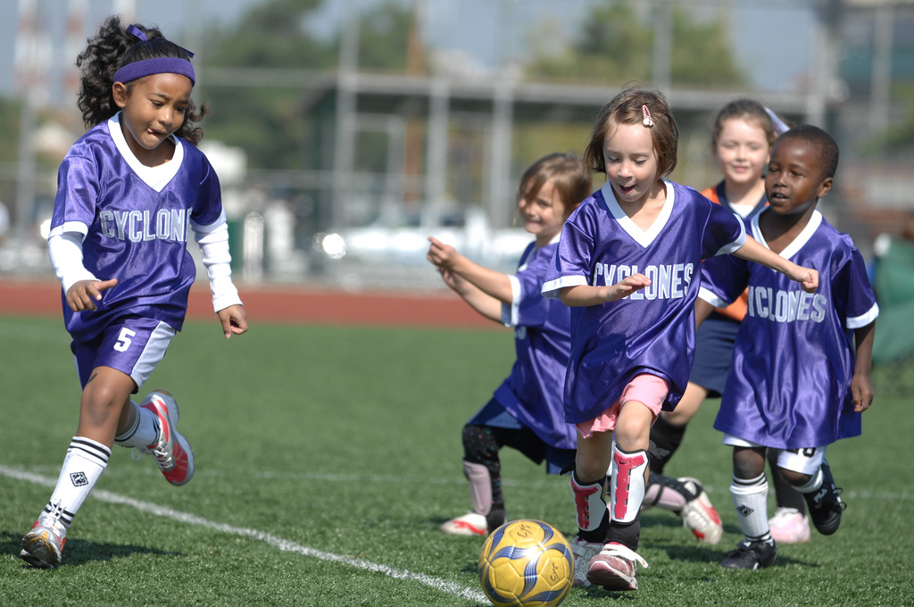
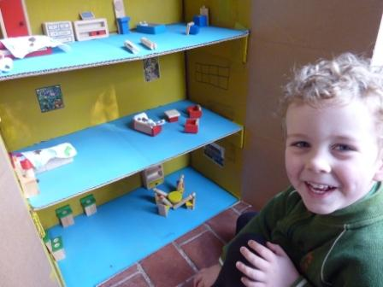
What games do you like to play and why?
Is it important to play?
Why do you think that? What are we doing when we play?
Why do we play?
This Photo by Unknown Author is licensed under CC BY-ND
This Photo by Unknown Author is licensed under CC BY-SA
Notes:
This slide opens up the question of why we play for discussion. Why do we play? What games do you like to play and why? Is it important to play? Why do you think that? What are we doing when we play? Children are encouraged to think about the purpose and enjoyment of playing. Humans show curiosity about their world when they play. The emphasis here is that humans learn through play and that playing is important for the development of human minds.

Slide 5
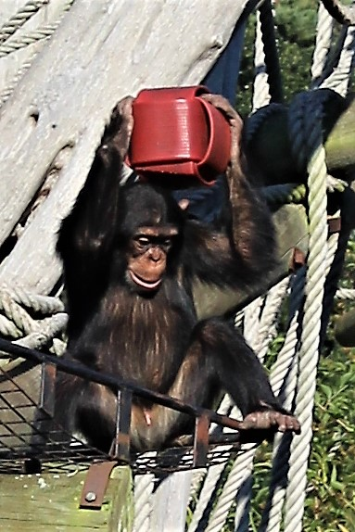
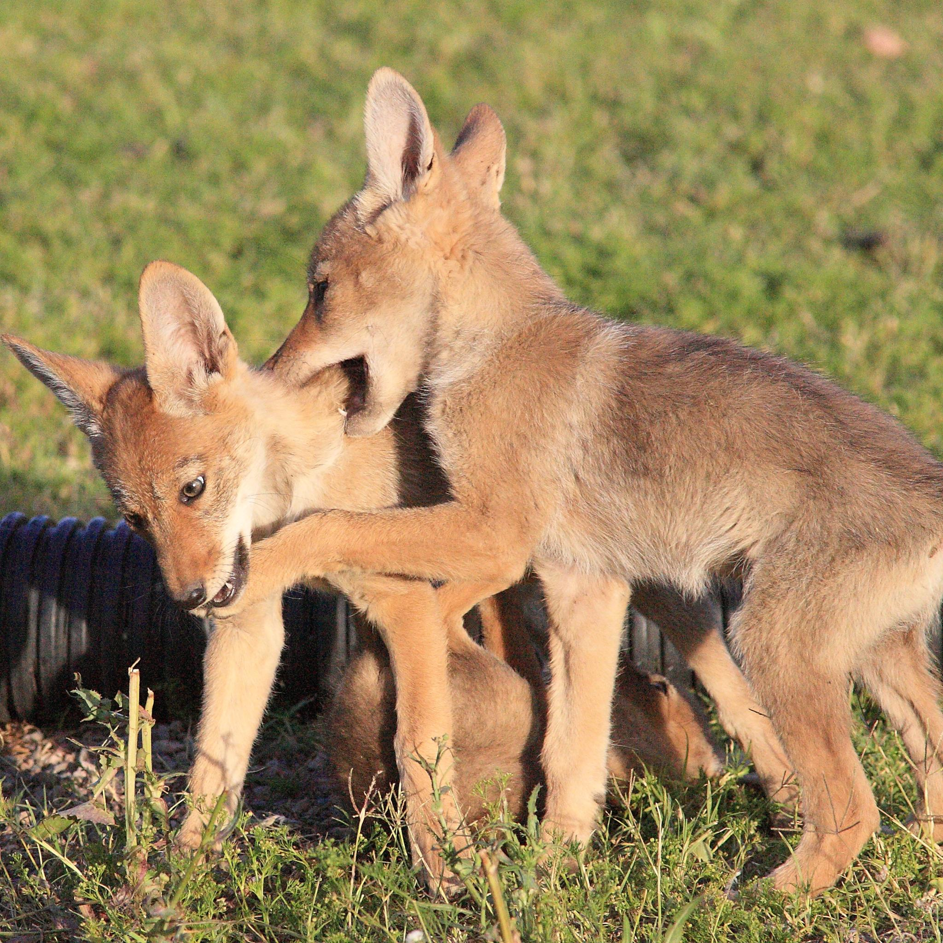
Do animals play?
Why might animals play?
Why might animal babies play?
Velu is playing with a box.
https://www.youtube.com/watch?v=UoN2qtdE1YI
Notes:
PP Slide 5 - Show embedded film about lion cubs.
https://www.youtube.com/watch?v=UoN2qtdE1YI
Children are now asked to consider if animals play Do animals play? Give examples. Why might animals play? Why might animal babies play? Discussion could include ideas about play enabling us to find things out about objects and our environment. Very free and open discussion to allow creative thinking. The slide shows Velu, a four-year-old chimpanzee at Edinburgh Zoo, playing with a red box. Animals also seem to show curiosity about their world when they play. Again, here the emphasis is that animals learn through play and that playing is important for the development of animal minds. Different animals play in different ways. Physical or ‘locomotor’ play can help young animals develop muscles and reaction times, social play can help them learn how others react, and object play might help them to learn how objects behave.

Slide 6
What is curiosity?
Do you ever wonder about things?
Do you ever wonder about things you don’t know?
What do you do when you wonder?
Hmmmmm?
What do you feel like when you are wondering?
What do you think your mind is doing when you are wondering?
Notes:
What is curiosity?
Do you ever wonder about things? Do you ever wonder about things you don’t know?
What do you do when you wonder?
Do you wrinkle your brow? Do you widen your eyes? Are you wondering about wondering right now? Have a look around at everyone’s faces. What do they look like?
What do you feel like when you are wondering? What do you think your mind is doing when you are wondering?
The human mind has an amazing super power: it can be aware that is does not know something! Can you think of something you don’t know? What is that? How can your mind know that it does not know something?
When you are wondering, your mind is in a state of curiosity. Curiosity is a strong feeling or a wish to know something.
The Scottish philosopher David Hume once described curiosity as, ‘that love of truth, which was the first source of all our enquiries’. So, Hume is saying that philosophers like to find out the truth about things and that this whole process begins with being curious. It begins with wondering about things. When we are curious and wonder about things, we ask questions. Curiosity and wondering are the motivators for asking questions: they force us to ask questions. We ask questions in order to find out what we desire to know.
Curiosity is the driving force behind research in science, technology, engineering, philosophy, psychology and even areas such as art or music.
Are we only curious so that we can gain knowledge? When we play or do a puzzle, we are being curious, but we don’t do it just for the knowledge. Curiosity also drives us to have new experiences, such as trying a new kind of milkshake. We enjoy being curious. So maybe being curious and wondering are really valuable qualities of the human mind.

Slide 7
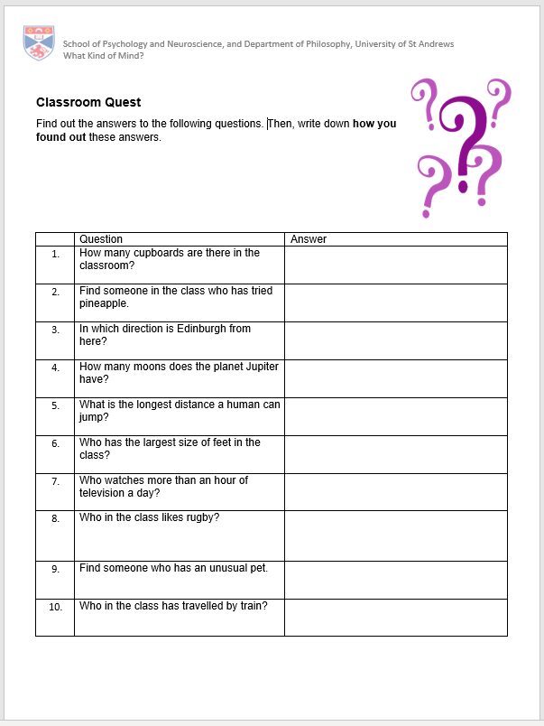
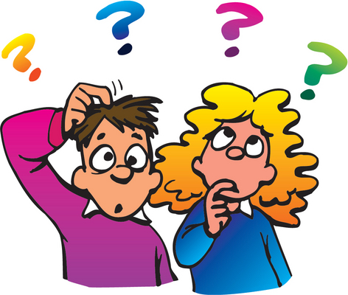
Are you curious?
Do you like to ask questions?
Do you like to find out answers?
See how many answers you can find in our Classroom Quest!
Notes:
Resources: PP Slide 7; Worksheet – Classroom Quest
Instructions:
The children are asked to communicate with others in the class to complete the questionnaire. They also have to record how they found out this information. Did they ask someone? Did they have to look it up somewhere? Did you enjoy that? Why was it fun? What have you learned? What is the most interesting thing you have learned?

Slide 8
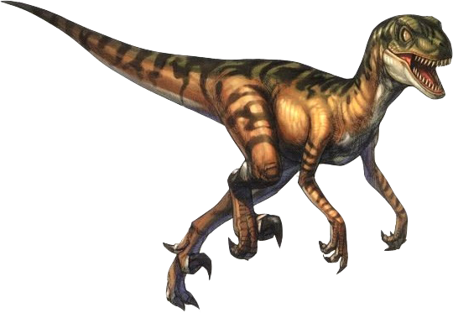
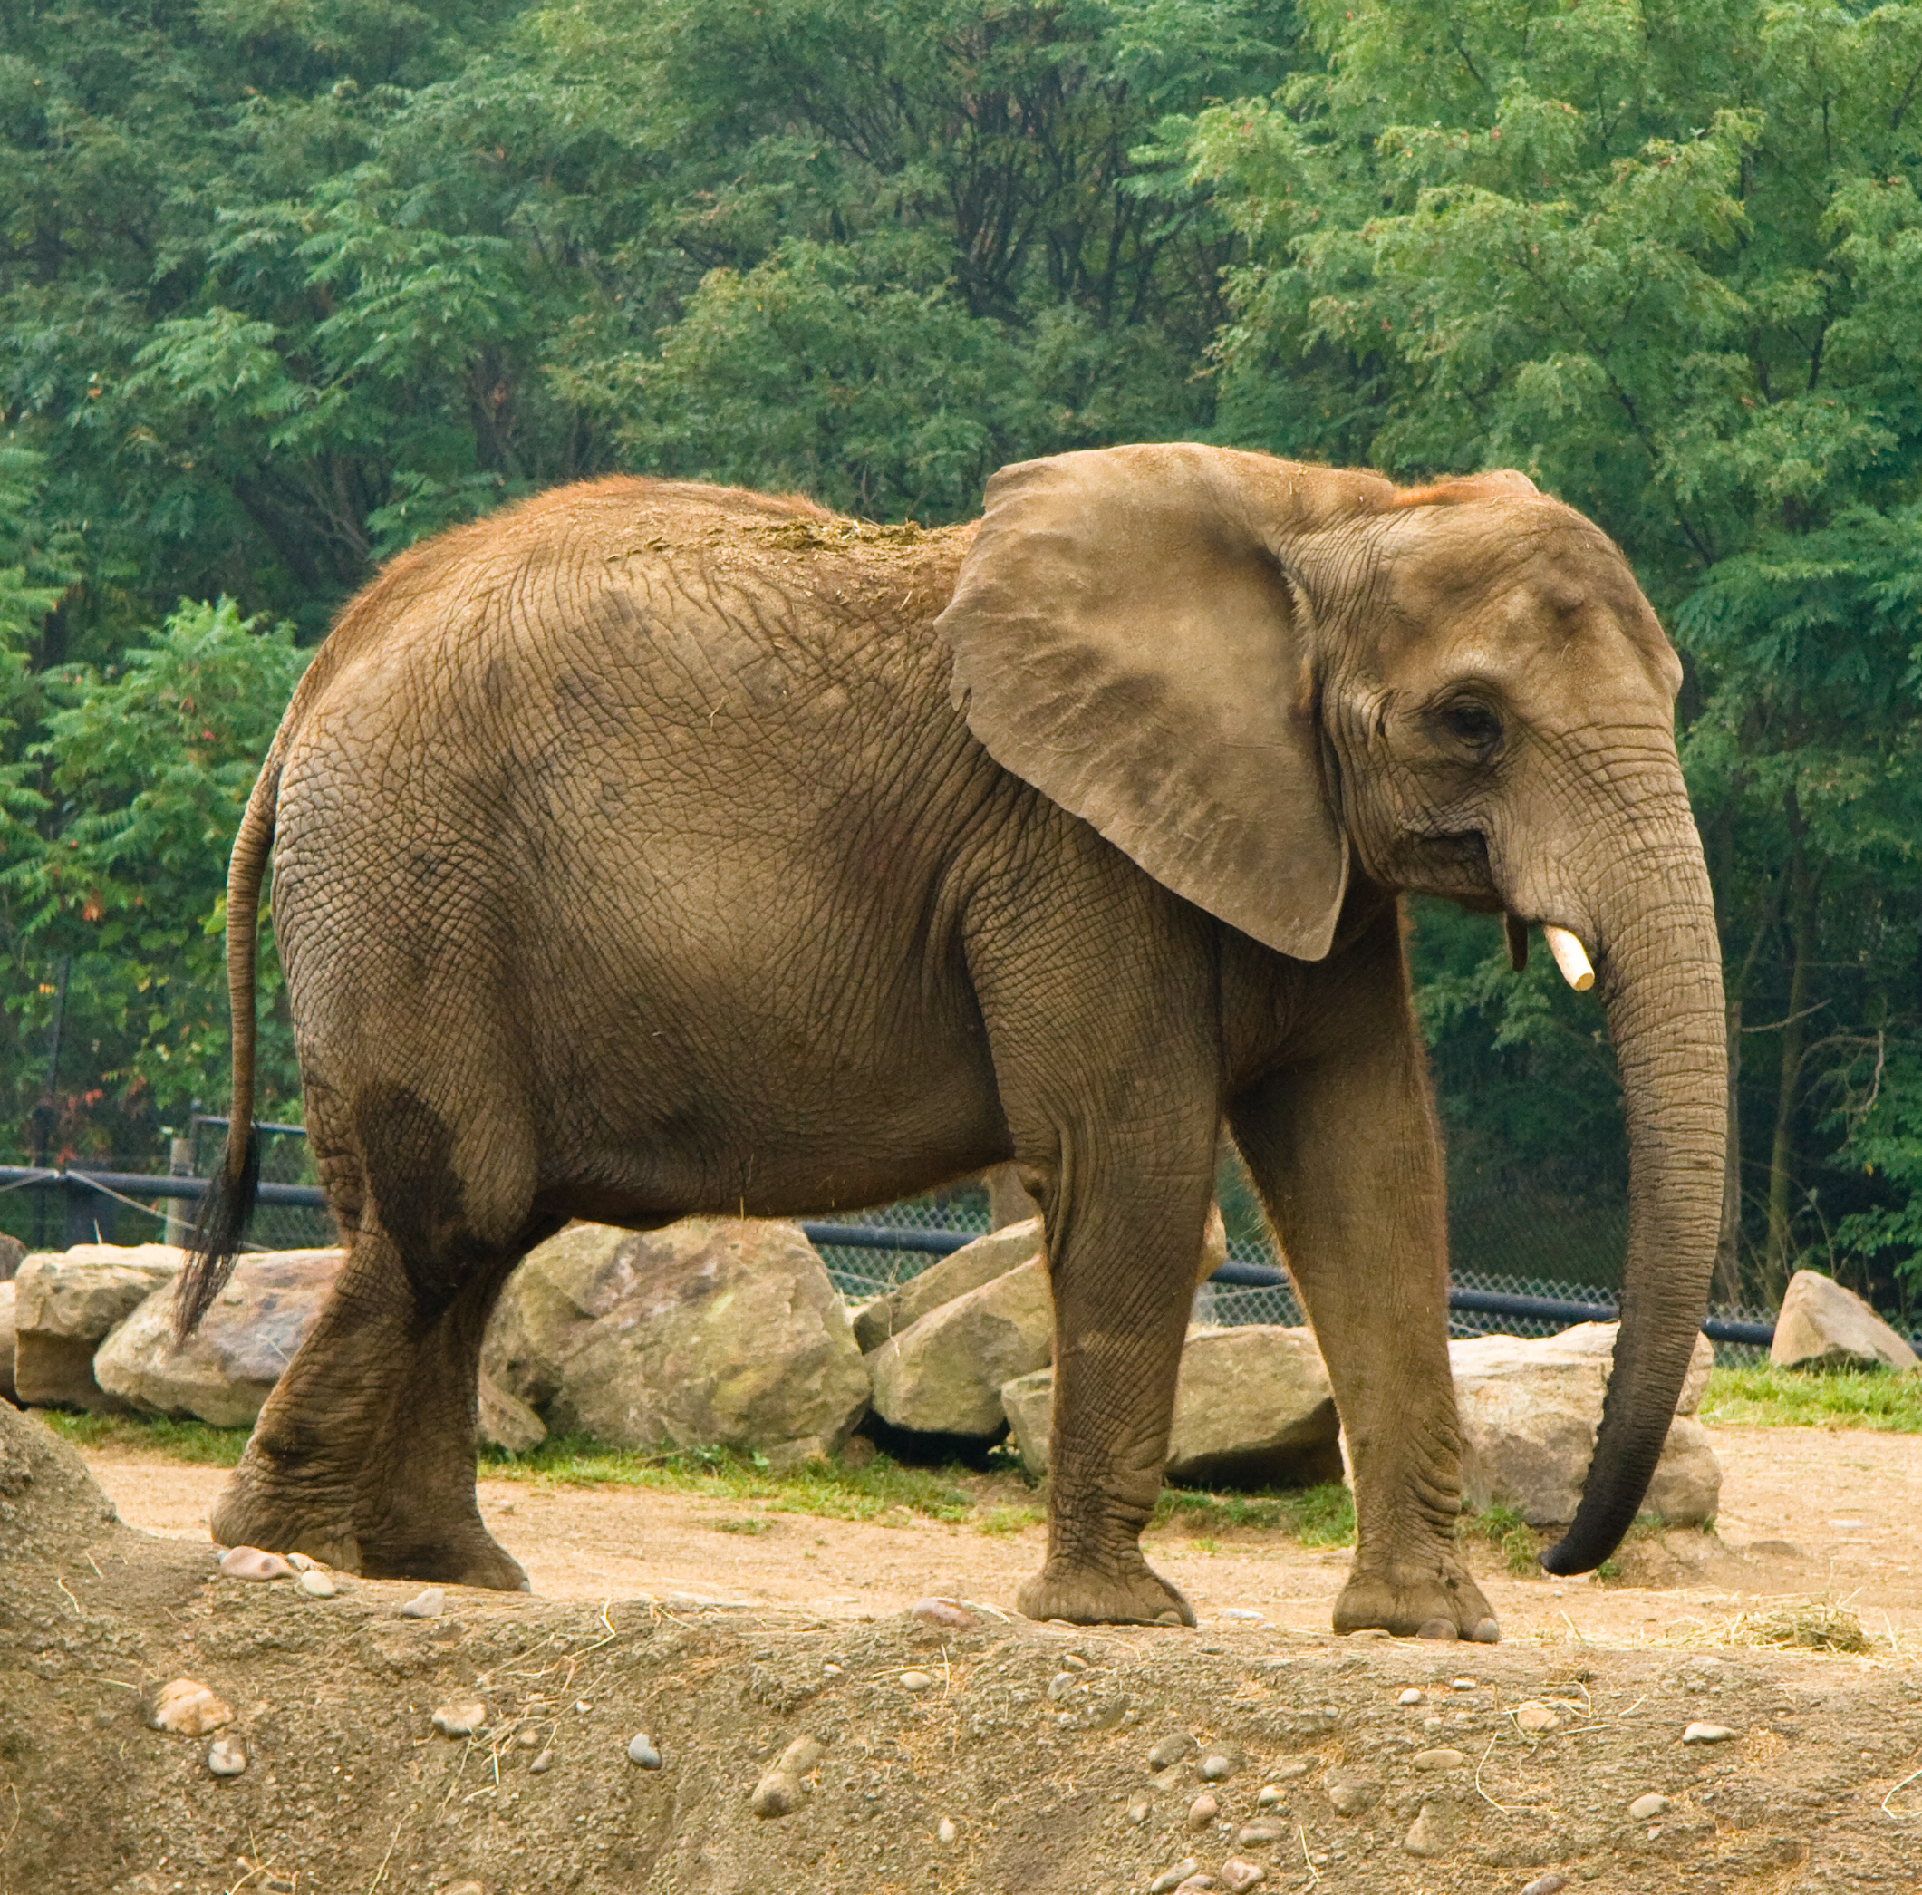
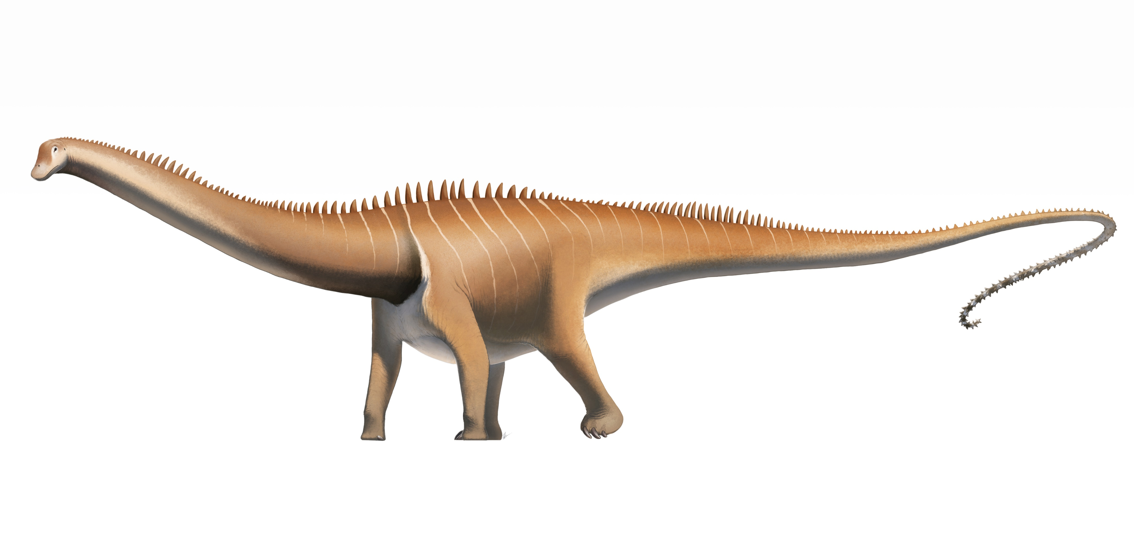
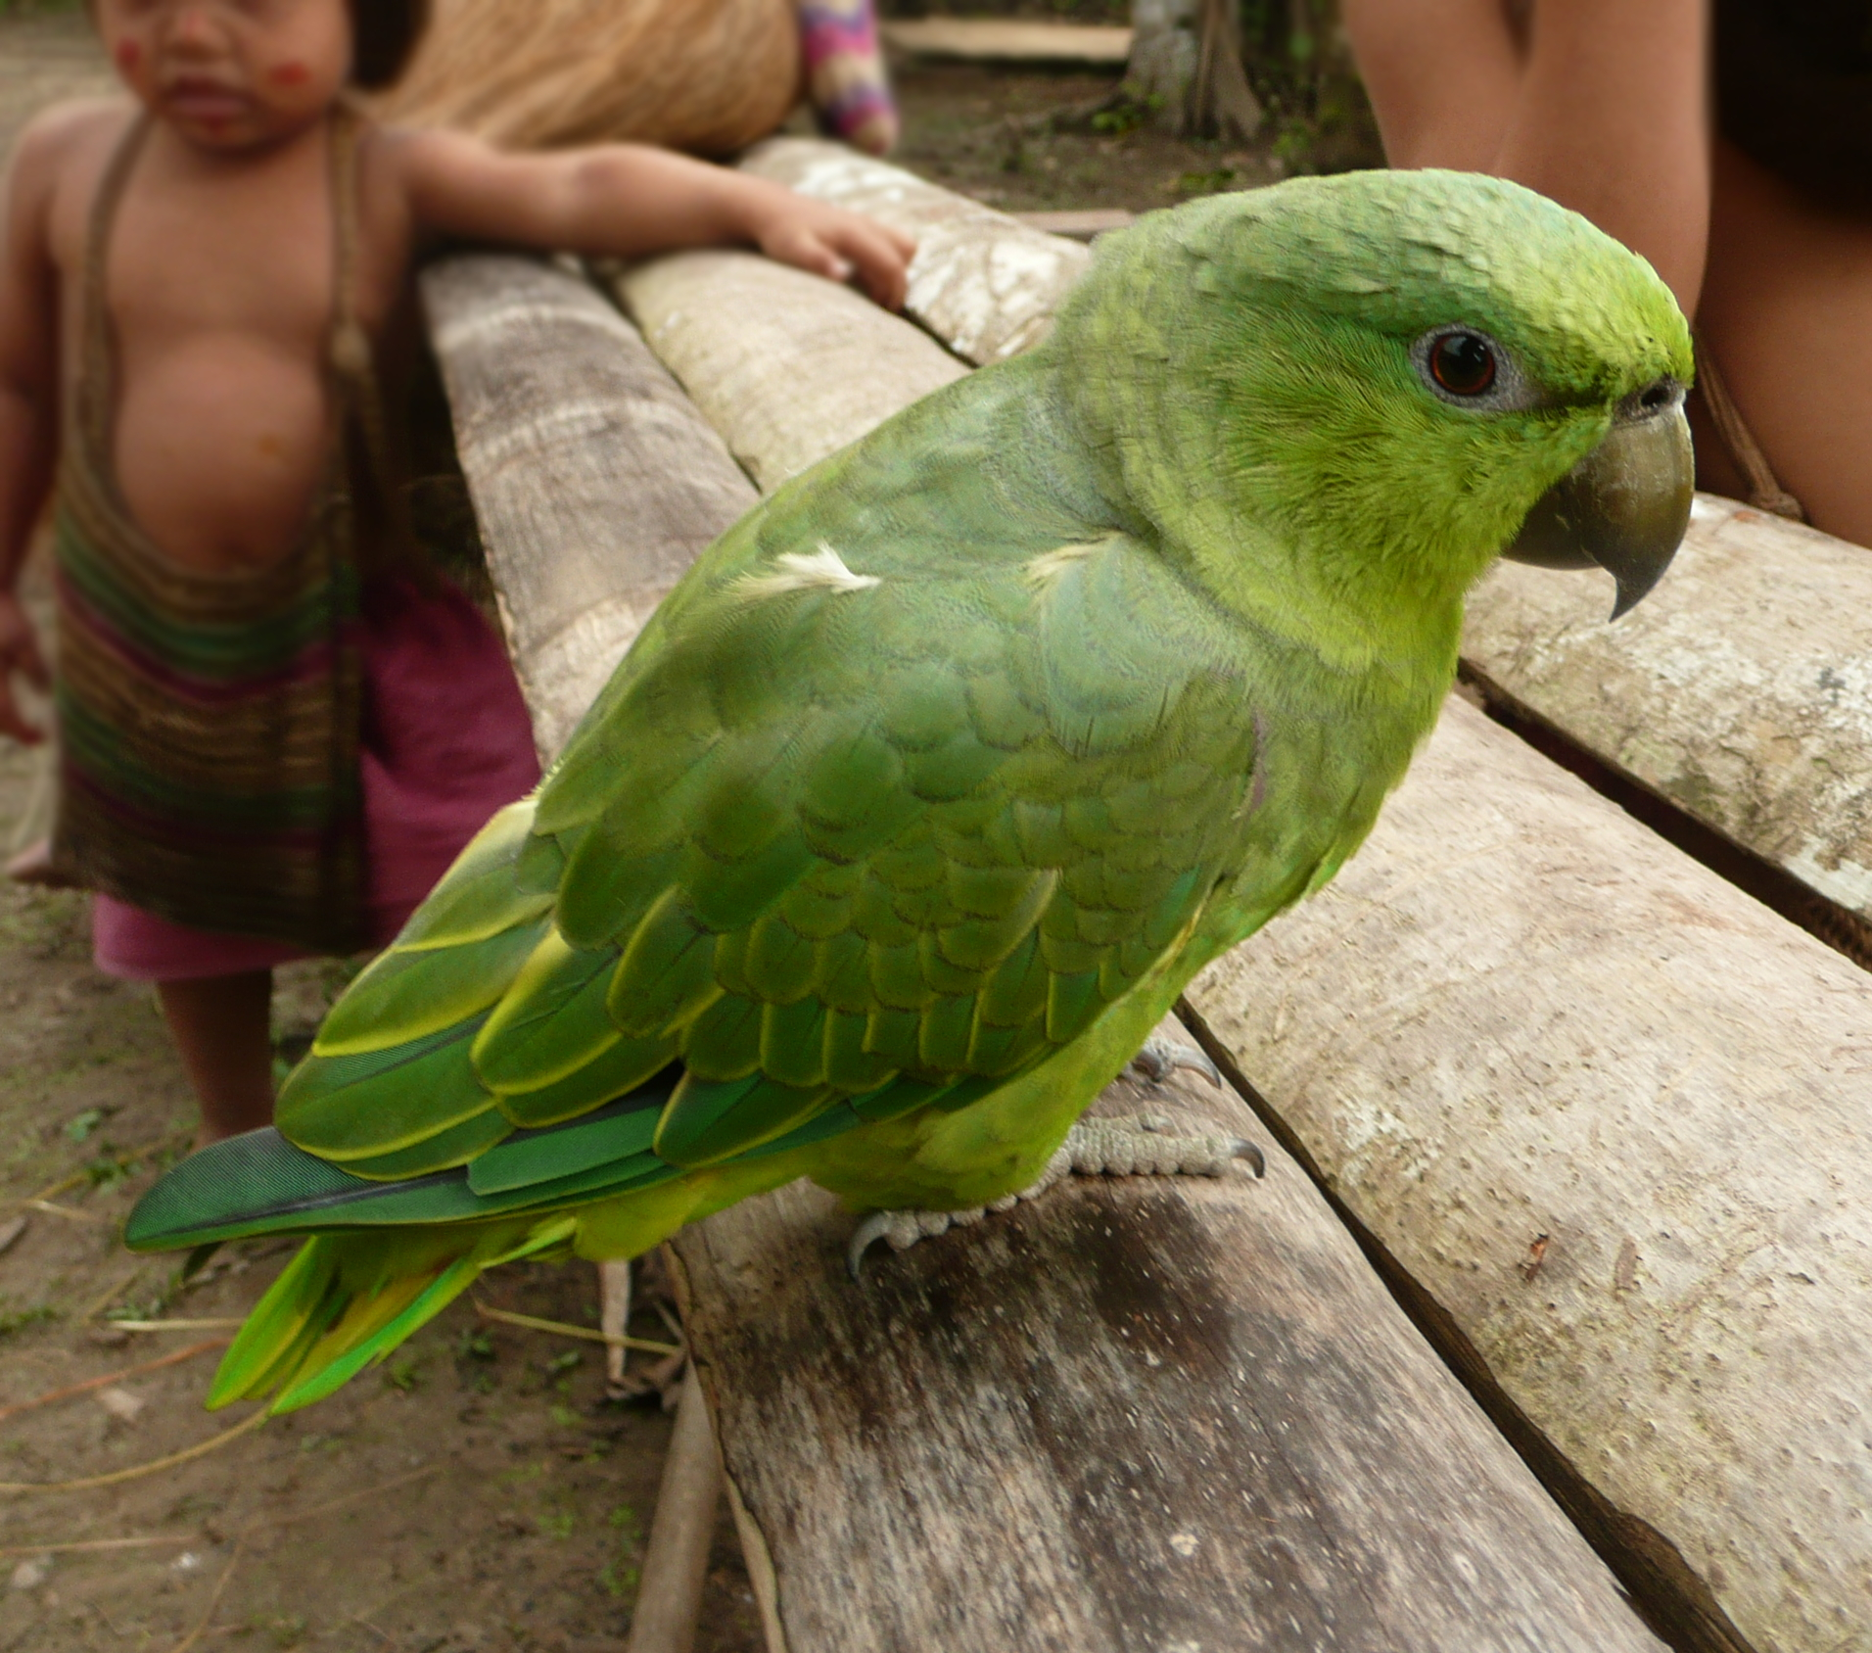
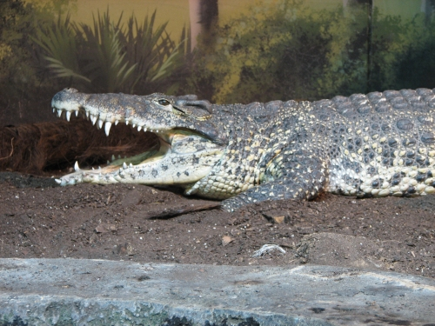
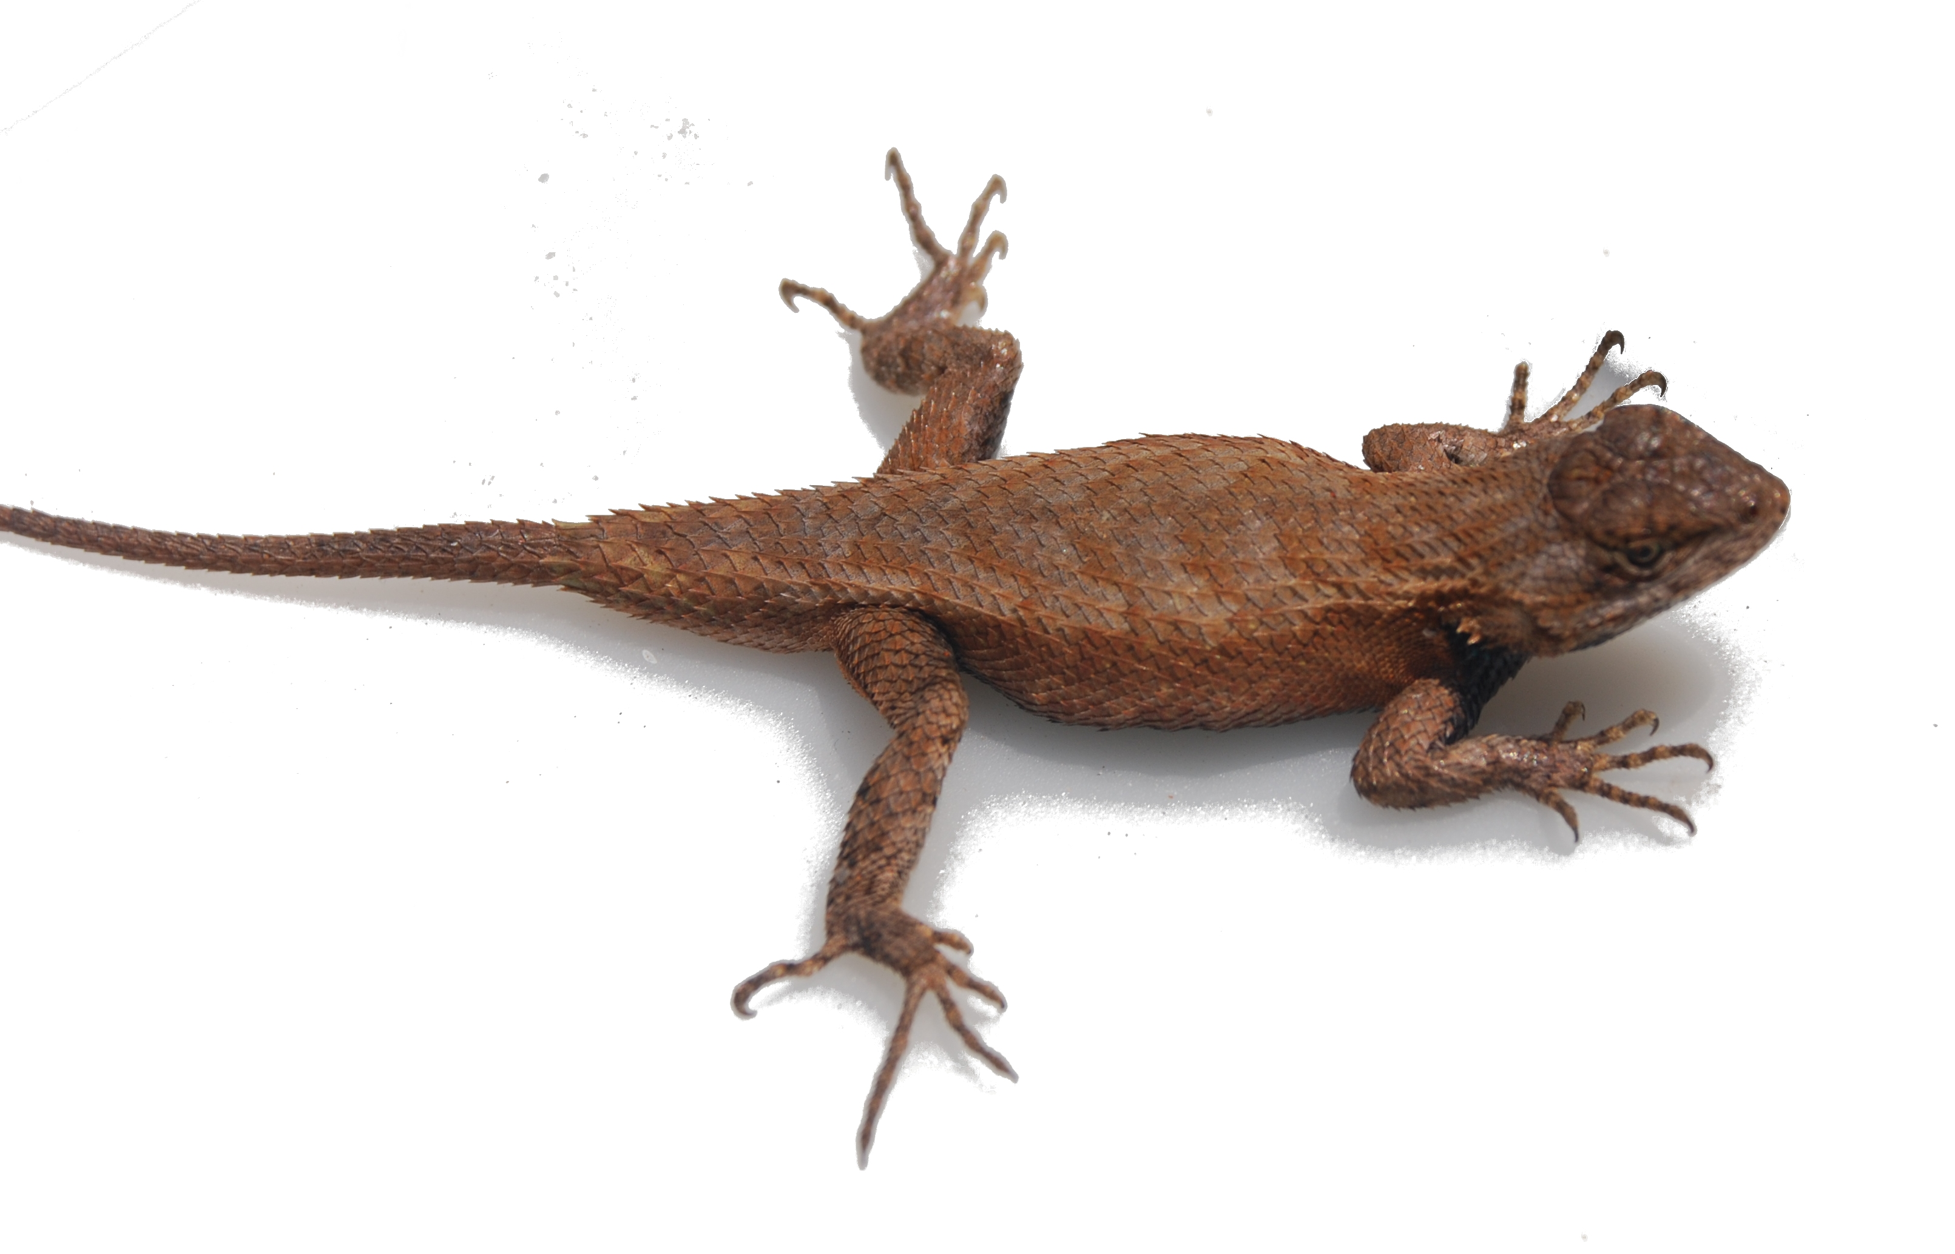
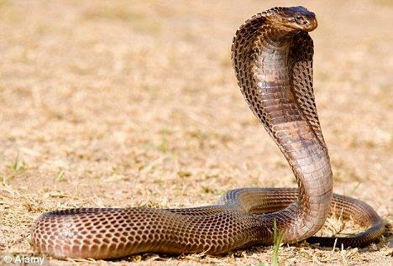
Birds and Humans Family Tree
Ancestral amniote
Synapsids
Dynapsids
Archosaurs
Lepidosaurs
Mammal Like Reptiles
Dinosaurs
Squamates
Mammals
Non-avian dinosaurs
Humans
Crocodiles
Lizards
Snakes
Birds
Notes:
This phylogenetic tree shows that our common ancestry with parrots is much further back than with chimps or orangutans. Parrots are birds: birds are the only living group of dinosaurs! Our common ancestor was something like a lizard.

Slide 9
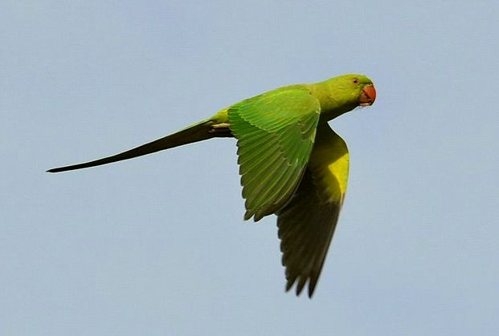
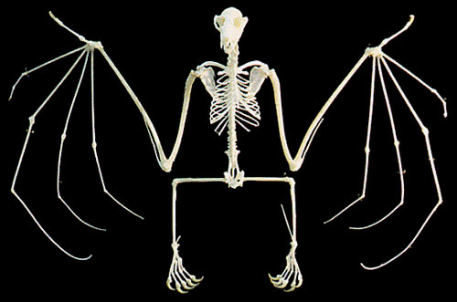
Birds evolved from dinosaurs!
https://www.youtube.com/watch?time_continue=6&v=eaWb0UUNc00
Notes:
This slide shows an illustration of the way birds may have evolved from dinosaurs. The film clip explains this further.

Slide 10
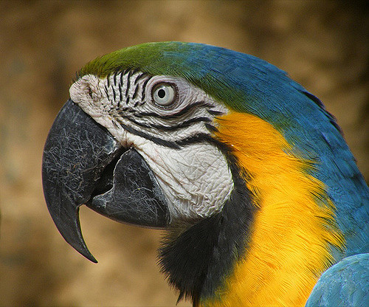
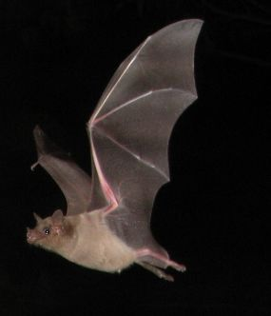
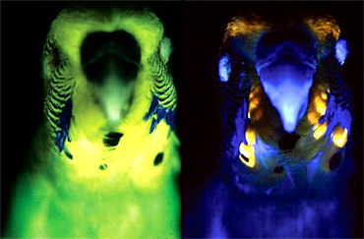
Parrots are amazing!
Parrots have no hands; they interact with their world with their beaks and feet.
Parrots’ vision is much better than that of humans: they can see ultra-violet light!
How did bats ‘see’ in the dark?
This Photo by Unknown Author is licensed under CC BY-SA
What would it be like to see in ultra-violet light?
Notes:
This slide provides some facts about parrots. Parrots have no hands, which is very different to humans; they interact with their world with their beaks and feet. Their vision is much better than ours – they can see UV light.
This links back to our exploration of how bats negotiate the world and how they perceive the world differently. Bats ‘see’ in the dark by using echolocation. Parrots can see ultra violet light. This gives them a different perception of the world. Ask the children what it might be like to see ultra violet light. The picture of the two parrots illustrates this.

Slide 11
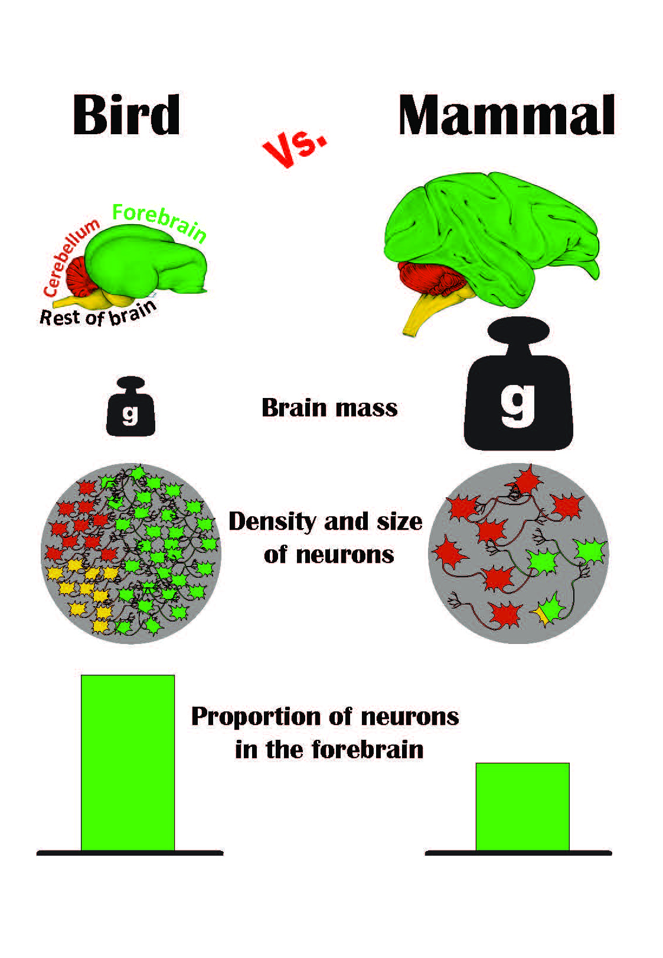
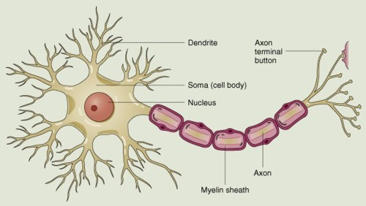
How might birds think?
Parrots’ brains are much smaller than those of primates, but they have denser neurons.
Neurons are the cells which make up the brain.
Neuron
Notes:
How might birds think? Their brains are much smaller than those of primates, but they have a greater density of neurons. Neurons are the cells that make up the brain. Birds are distant relatives to humans, but some species may have evolved dense brains (lots of brain cells) convergently. Convergent evolution is the process where different species independently evolve similar characteristics, without being closely related. For example, both finches and chimpanzees have evolved to use tools, even though these species are not closely related on the evolutionary phylogenetic tree.

Slide 12
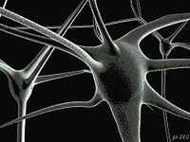
How might parrots think?
Like humans, parrots have lots of neurons in their brains.
Neurons:
Receive messages
Process messages
Transmit messages
They do this using electrical and chemical signals.
Neurons connect to each other.
They can transfer information quickly.
Notes:
This slide gives infomration about the function of neuron cells in the brain. Neurons are important for intelligence. Parrots have small brains in comparison to primates, but they have a greater density of neurons within those brains. Having denser neurons enables their brains to carry out more complicated processing of information.

Slide 13
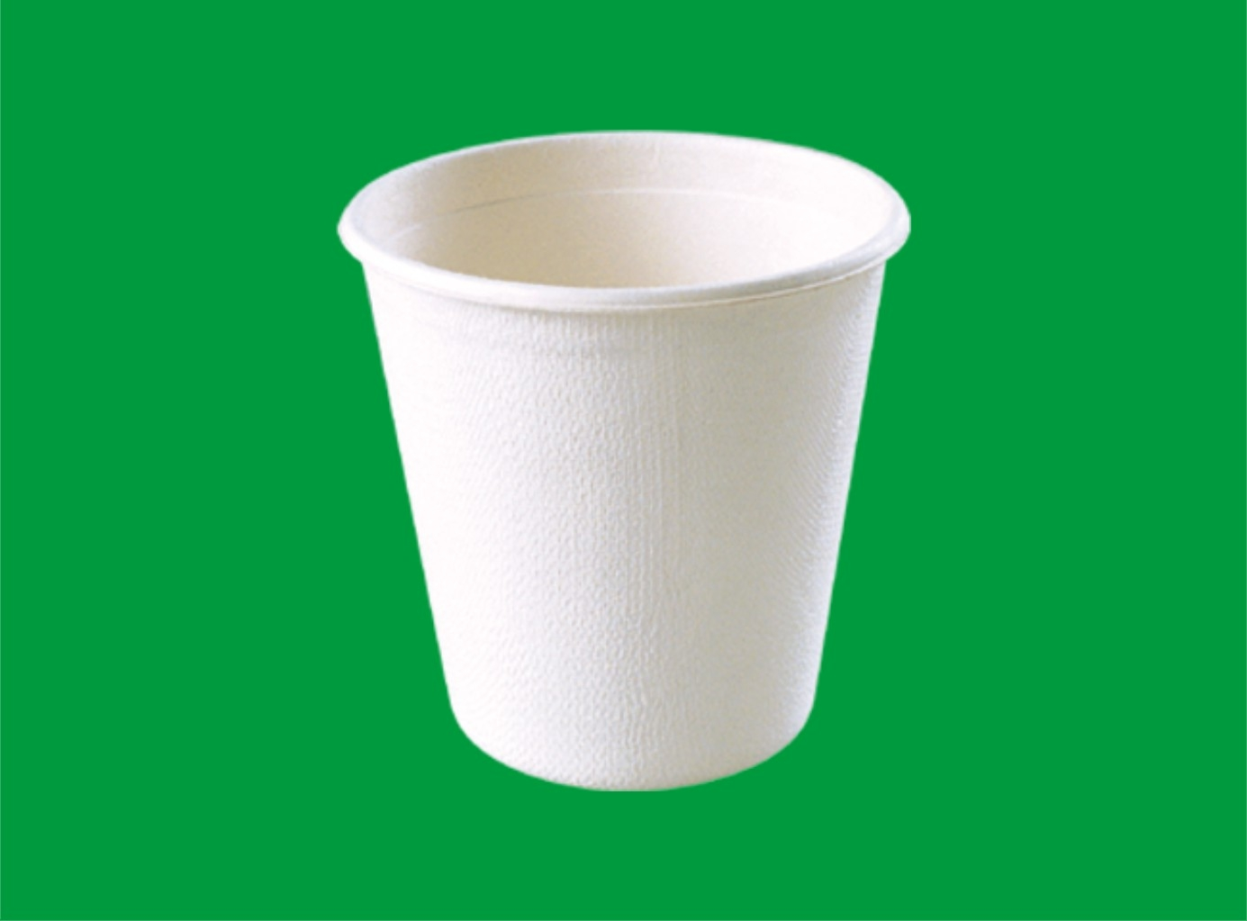
Bird Brains!
How many neurons can you pack into the skull?
Notes:
This slide illustrates the group activity whereby the children will try to pack ‘neurons’ into a space.
More than two groups can be used for this activity, but the packing technique should be alternated amongst the groups.
Each piece of paper represents a neuron: the cup represents the skull. The groups have instructions to pack the paper in a certain way, as follows:
Group 1: Each piece of paper has to be folded one at a time going into the cup.
Group 2: Each piece of paper has to be scrunched up one at a time going into the cup.
Whichever method is used, all pieces of paper must be put into the cup in exactly the same way. The cup cannot be overflowing.
Each group should record their findings on the worksheet. At the end of the task, the number of pieces of paper should be counted and recorded. The groups will then compare their findings

Slide 14
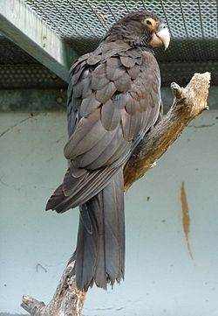
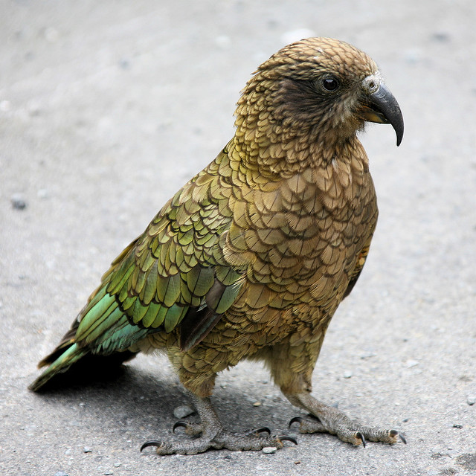
Are parrots curious?
Watch the film of the Vasa and Kea parrots.
Can they learn through playing with objects?
https://www.dropbox.com/sh/ae2l6f4wb6vusbr/AAC0Y4FYJNNc0zBi-efsc45la?dl=0&preview=Parrots.mp4
Notes:
Are parrots curious? Do parrots wish to find things out about the world? Can parrots play with objects?
Resources: PP Slide 12 with film embedded
Whole Group Discussion: Class Poll – Show of hands to establish base line response to the question at the beginning of the film. Show the film of the Vasa and Kea parrots with the blocks. Discussion about whether parrots can learn about objects through play. How would the parrot know which block to use? Could it just have been lucky? The researchers used the scientific method - unlike in the film, the birds had lots of trials.
Class Poll again at end of discussion – Are Parrots curious? Have you changed your mind about this?

Slide 15
The Scientific Method: Curious Parrots
Question
Hypothesis
Experiment
Results
Interpretation
Group A
Group B
How do parrots think about objects? Can they learn about objects by playing with them?
Parrots learn about objects by exploring them.
Hypothesis supported!
Parrots do learn about objects by exploring them.
Group A chose the correct block
more often than Group B to get the treat
Plays with
Does not play with blocks
Light
Heavy
Chooses block to release treat
Chooses block to release treat
Prediction: Given the chance to play with blocks, parrots will know which one to use to get a treat, than parrots who have not played with blocks.
Notes:
This slide demonstrates how the experiment with the parrots can be mapped onto the scientific method. It gives the hypothesis which the researchers tested with the parrots.

Slide 16
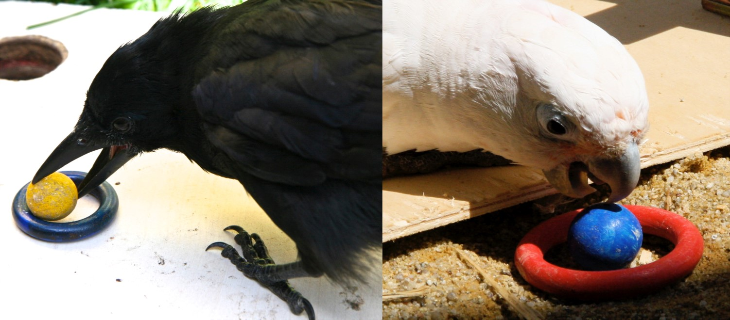
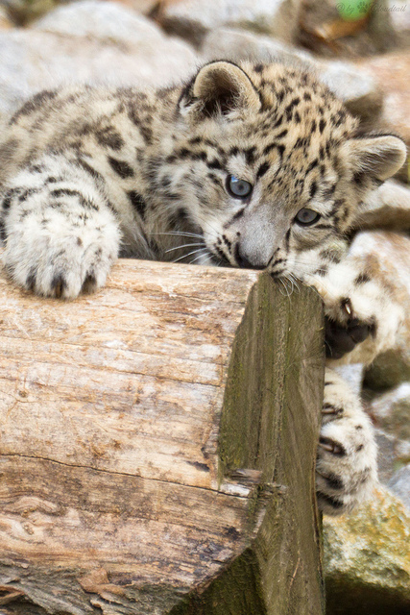
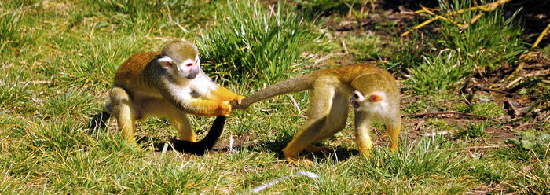
Why is play important?
Notes:
Different animals play in different ways. Physical or ‘locomotor’ play can help young animals develop muscles and reaction times, social play can help them learn how others react, and object play might help them to learn how objects behave.

Slide 17
Today we thought about:
Are parrots curious?
Are parrots intelligent?
Notes:
Recap the main points of lesson 5 as follows:
Playing is important for learning; Curiosity is helpful for learning and survival; parrots are curious; parrots may learn through play like humans. Birds are distant relatives, but some species may have evolved dense brains (lots of brain cells) convergently. Convergent evolution is the process where different species independently evolve similar characteristics, without being closely related. For example, both finches and chimpanzees have evolved to use tools, even though these species are not closely related on the evolutionary phylogenetic tree.

