Slide 1
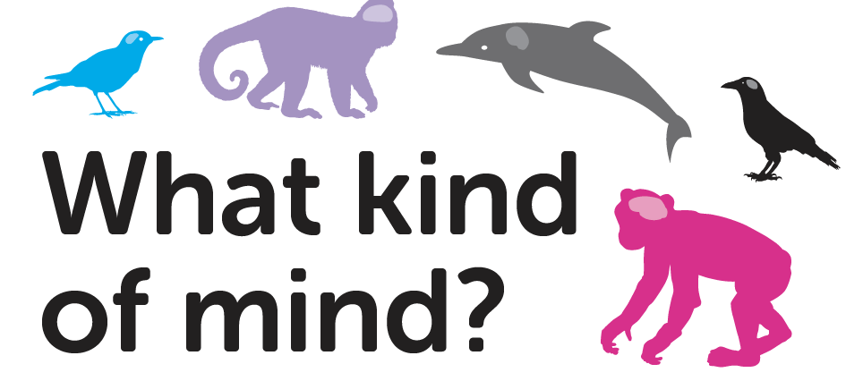
Lesson 4
School of Psychology and Neuroscience, and Department of Philosophy,
University of St Andrews

Slide 2
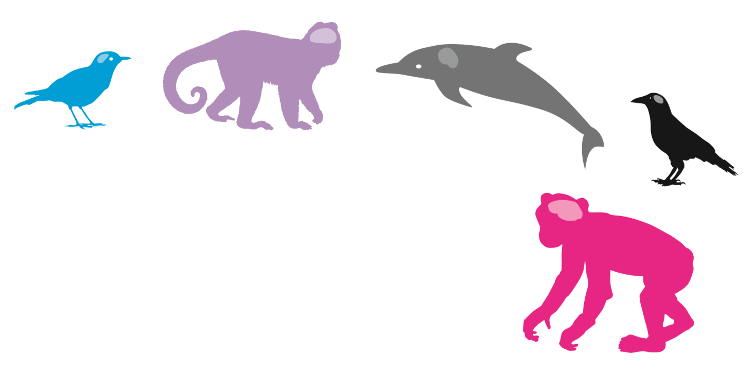
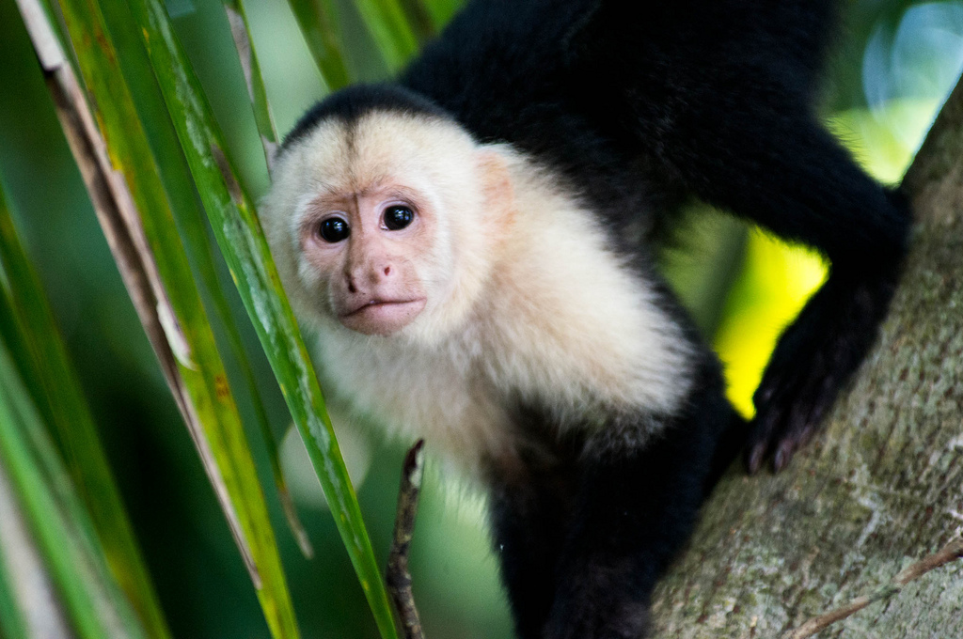
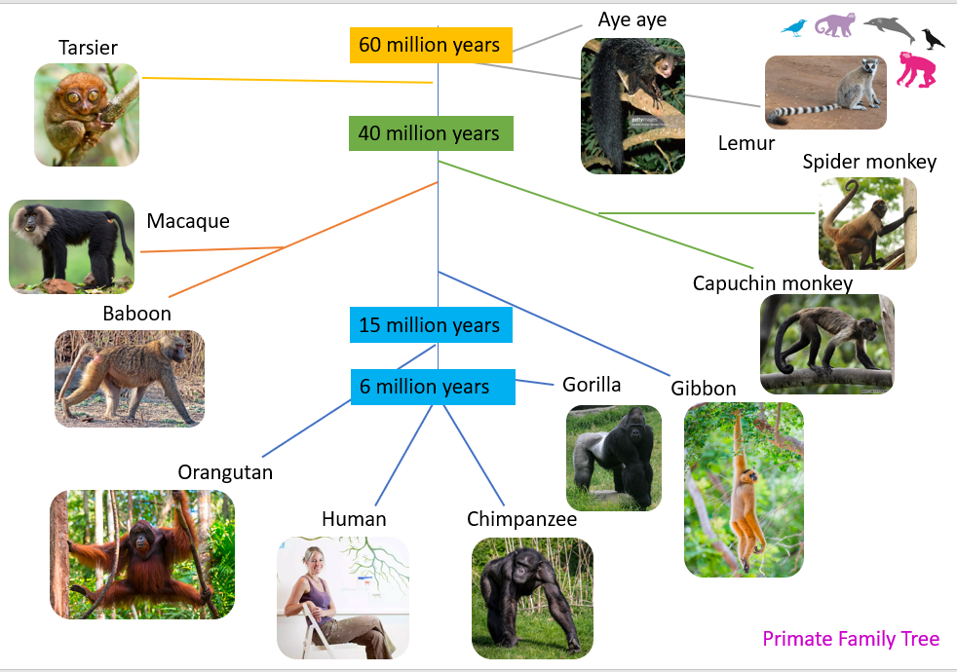
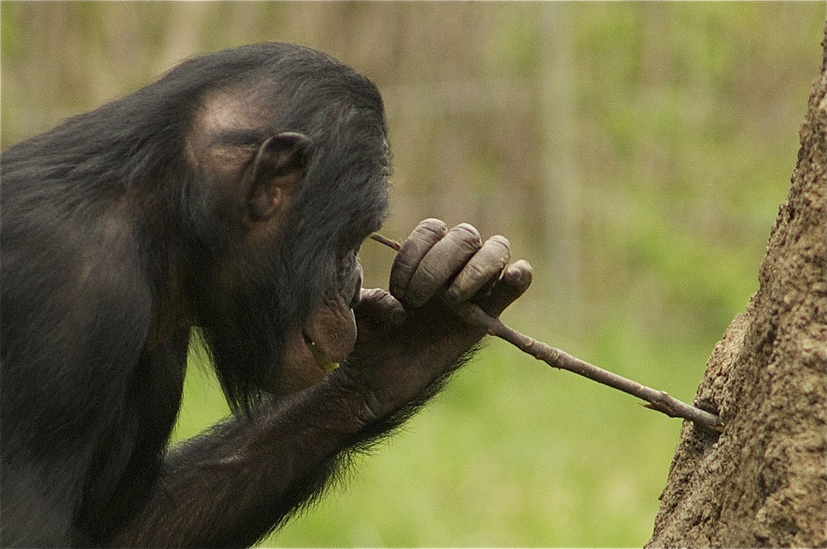
Last time we thought about:
Question
Hypothesis
Experiment
Results
Interpretation
Notes:
This slides gives a recap of the previous lesson. Recap the main points of the lesson as follows:
We thought about our primate family and placed them on a family tree. We thought about different primate hands and how chimps can use tools. We thought about how our hands and brains have evolved and how interacting with our environment has shaped human minds. We then thought about whether human babies and Capuchin monkeys might think about objects in the same way.

Slide 3
Chimpanzees are our closest primate relatives
Notes:
This slide reminds the children of how chimps and humans are placed on the primate family tree.

Slide 4
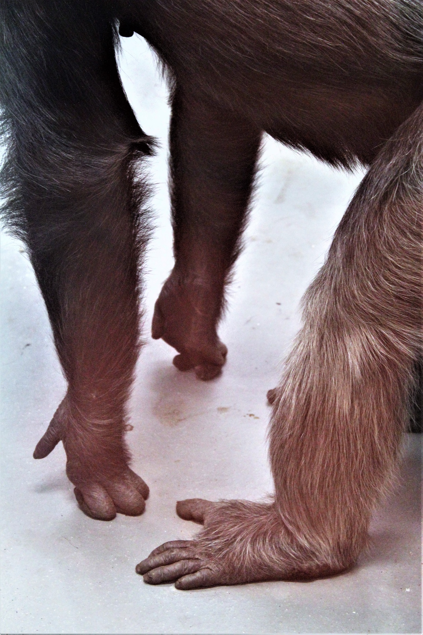
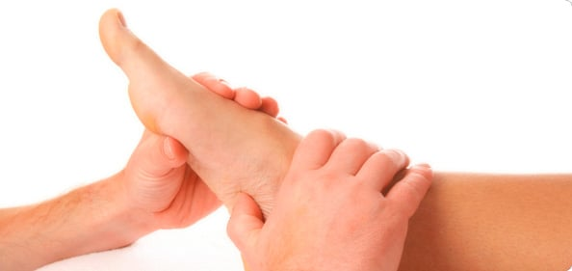
Chimpanzee and Human Hands and Feet
What similarities and differences can you spot between human and chimp hands and feet?
Notes:
This slide shows human and chimpanzee hands and feet for comparison. The chimp is Edith who lives at Edinburgh Zoo.
Chimp hands and feet are far hairier than humans. Chimp feet are more like their hands, whereas human feet are elongated and do not have an opposable digit (thumb).

Slide 5
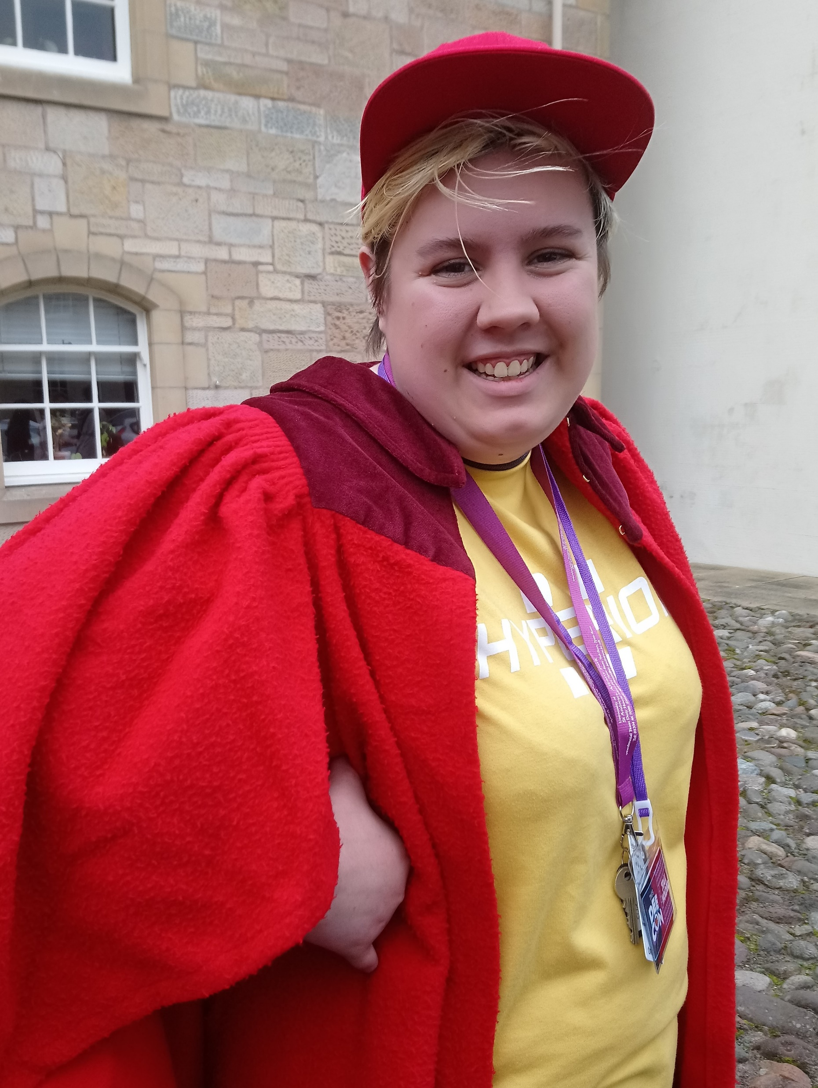
Faces: What similarities and differences can you see?
Notes:
This slides asks the children to consider the similarities and differences between human and chimp faces. The girl is a philosophy undergraduate student at St Andrews and she is wearing the traditional red gown.
Their faces are similar in that they have eyes, ears, nose, mouth and brow. They differ in that human eyes have white around their irises, whereas chimps have a darker brown. Chimpanzees do not have foreheads, as humans do, but they do have large ridges in the area above the eye sockets. Humans have formed chins and are the only primates with this feature.

Slide 6
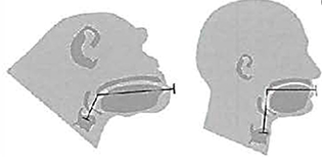
Vocal Apparatus
There are similarities and differences between chimp and human vocal apparatus.
Notes:
This slide draws the attention to the vocal apparatus of the two species. These have evolved differently but still share similarities. This gives rise to the question of whether chimps are talking when they make sounds. Do they have language?

Slide 7
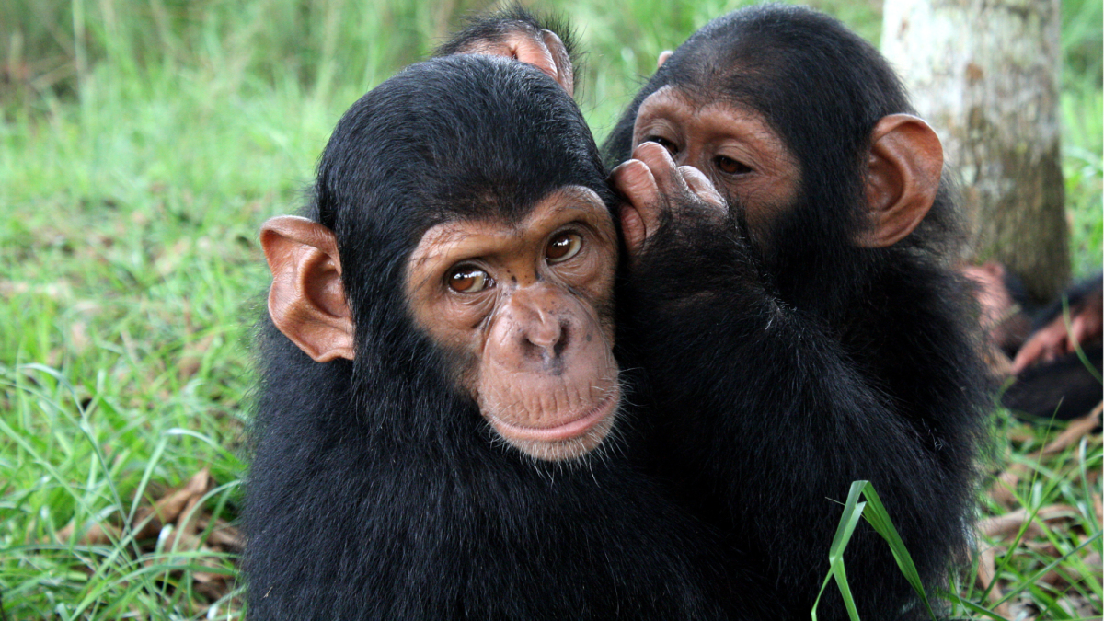
Do chimps ‘talk’?
Do chimps communicate with each other?
Do they manage to understand each other?
Do chimps have a language?
Notes:
This slide poses the question of whether chimps can ‘talk’ and if they have a shared language with which they can communicate effectively. The children are invited to offer their ideas about this.
Just as human and chimp bodies have evolved, so have their minds.
Emphasise again that just as their bodies have similarities and differences, so might their minds. So, do chimps ‘talk’?

Slide 8
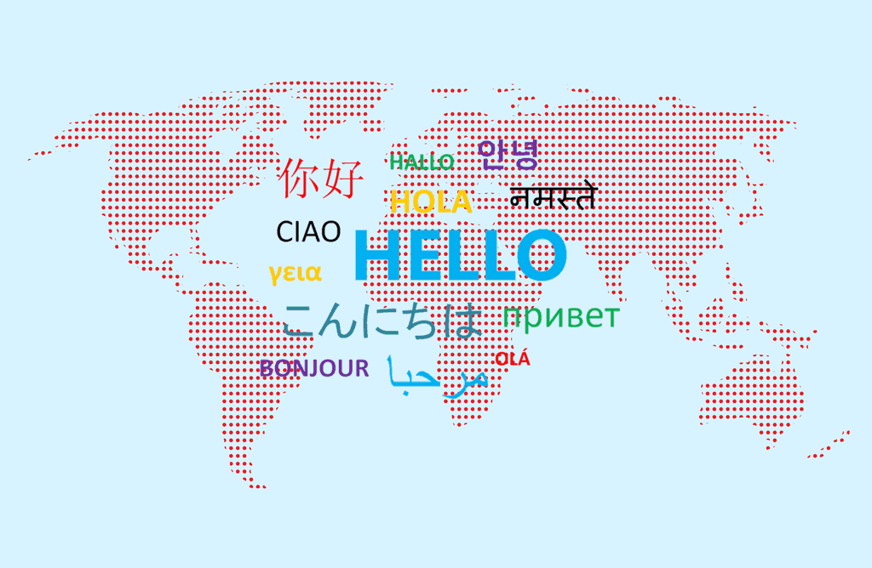
Think about this:
What is language?
How did language evolve?
Do any other animals have language?
What is a gesture? Can gestures be seen as language?
Notes:
Ask the children which languages they can speak.
Language is a socially learned tool of communication. We learn the language we speak from others around us.
Some researchers, such as Noam Chomsky, argue against that claim and state that we are all born with the facility to learn language and so this is innate.
Language may have evolved to help humans communicate with each other, and so survive.
Primates, including humans, use a combination of vocalisations, gestures and body language to communicate.

Slide 9
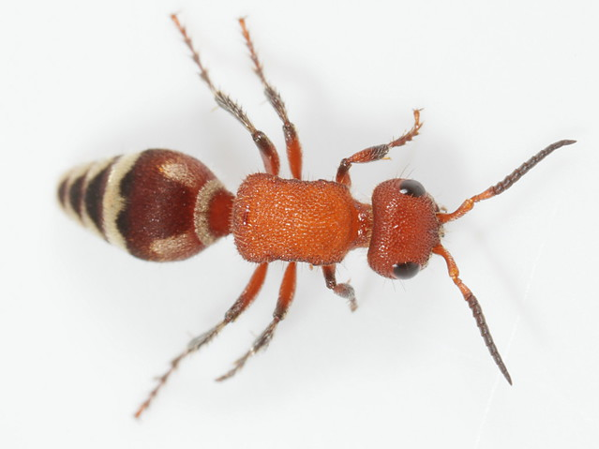
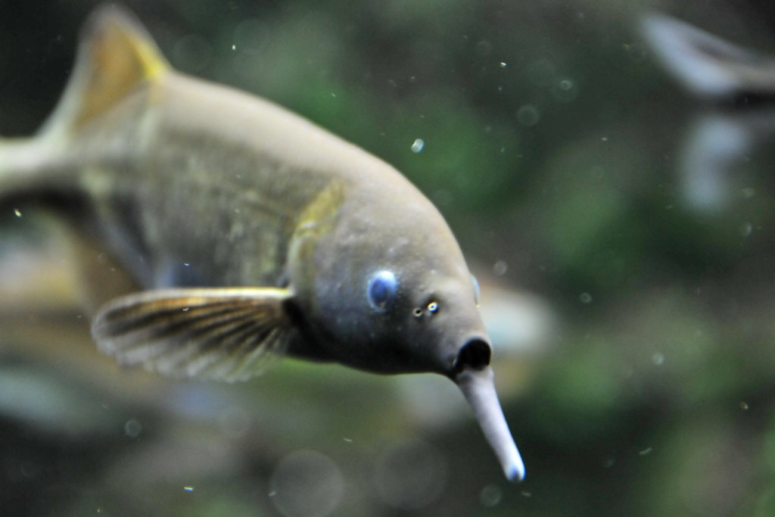
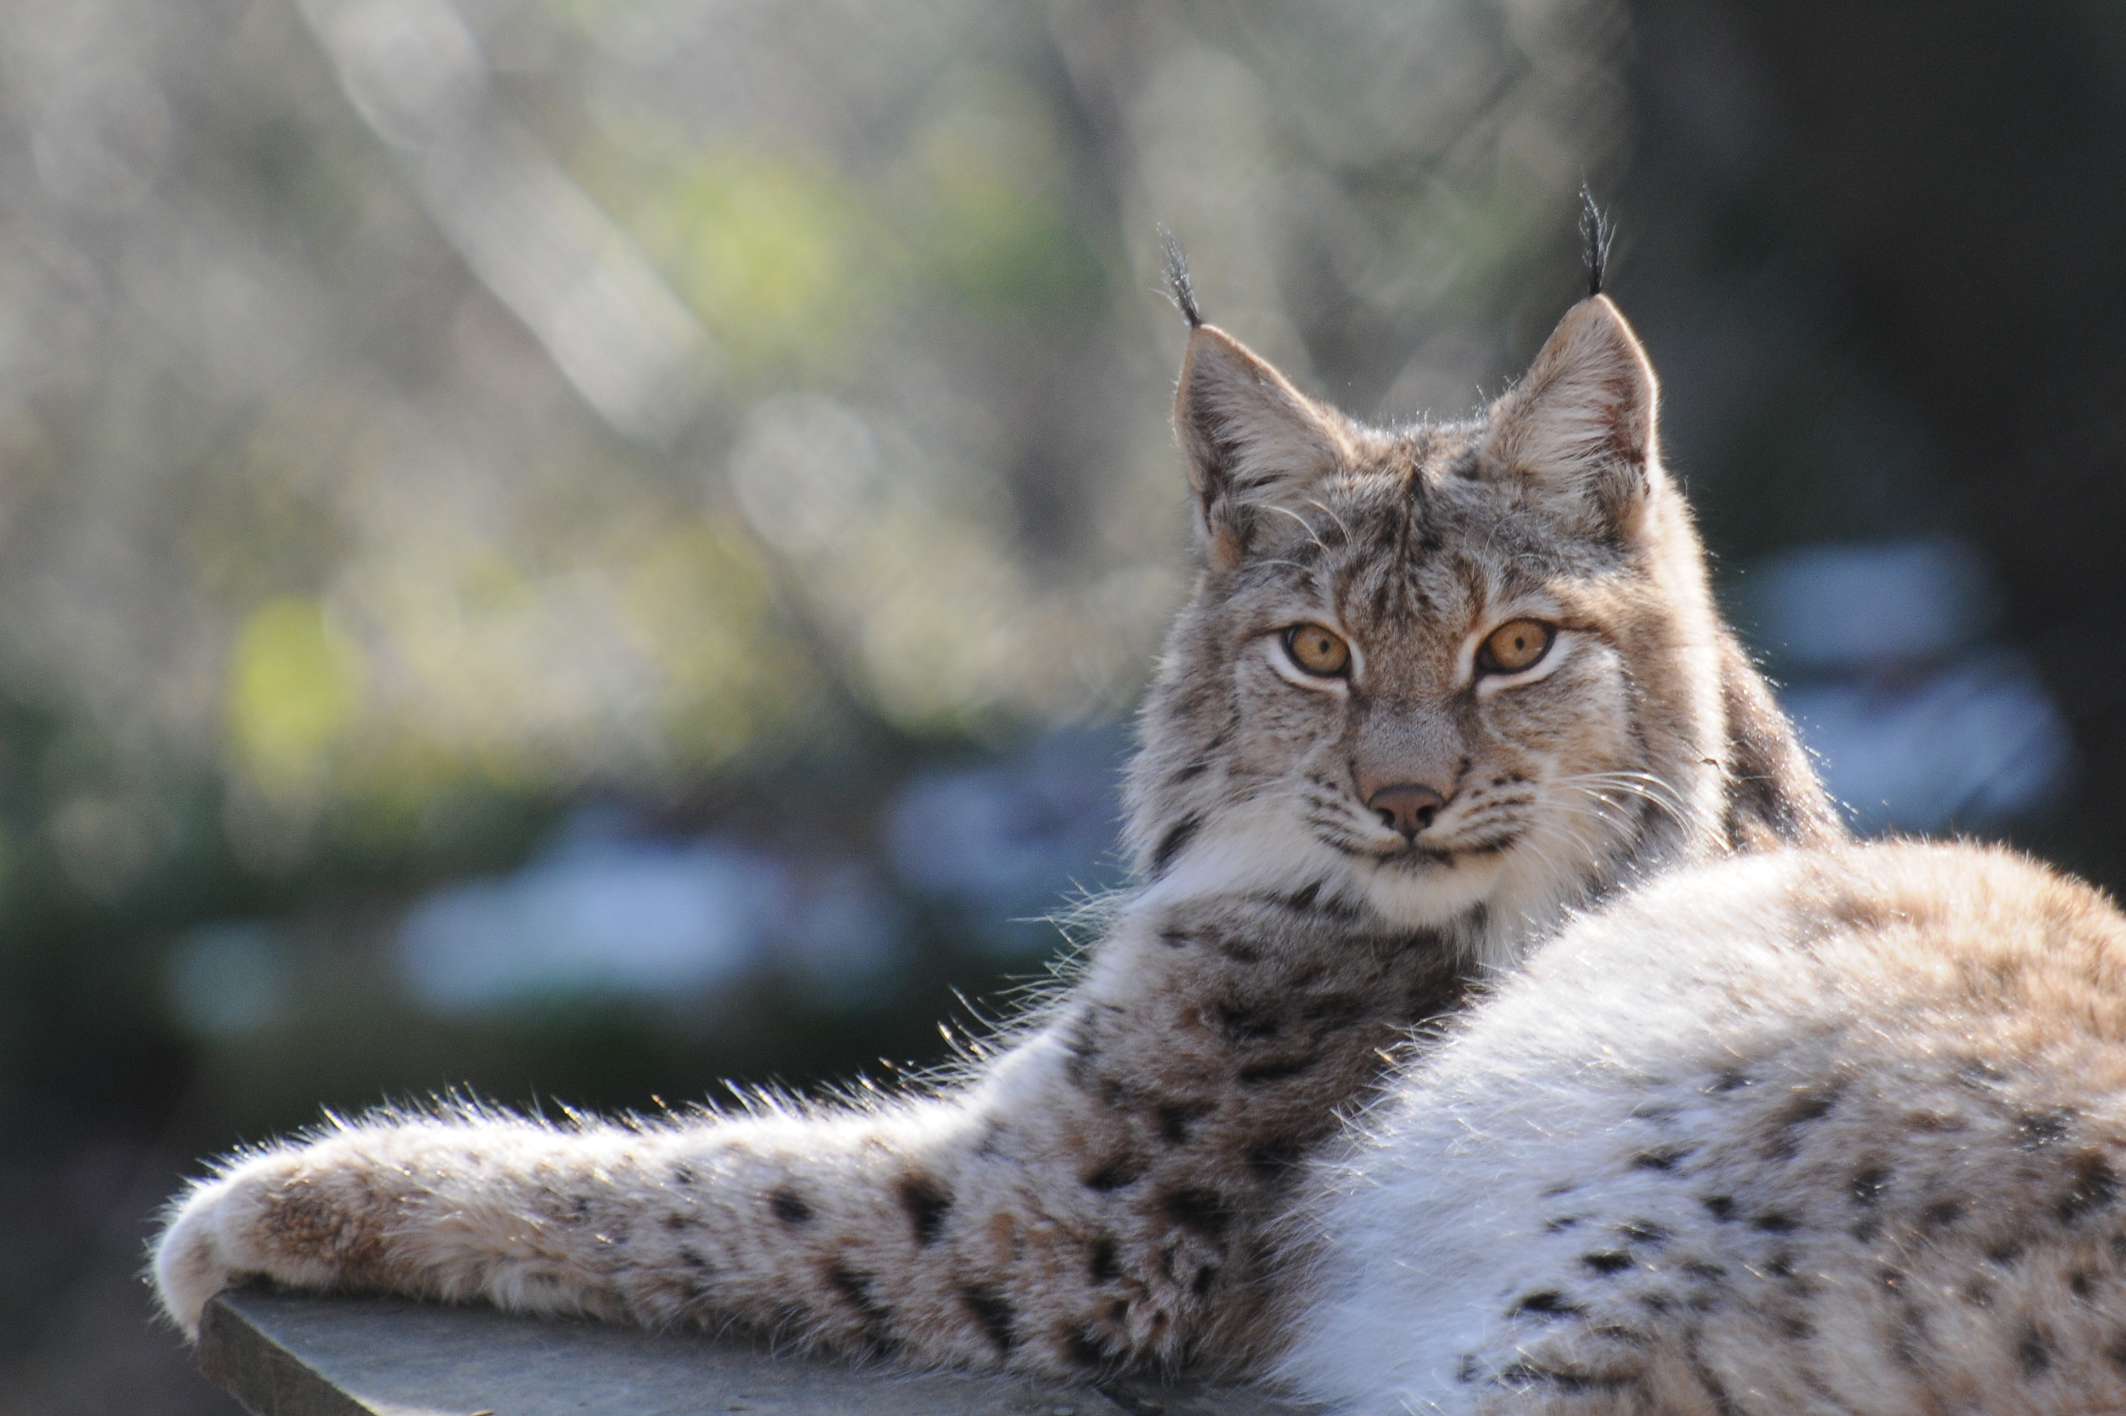
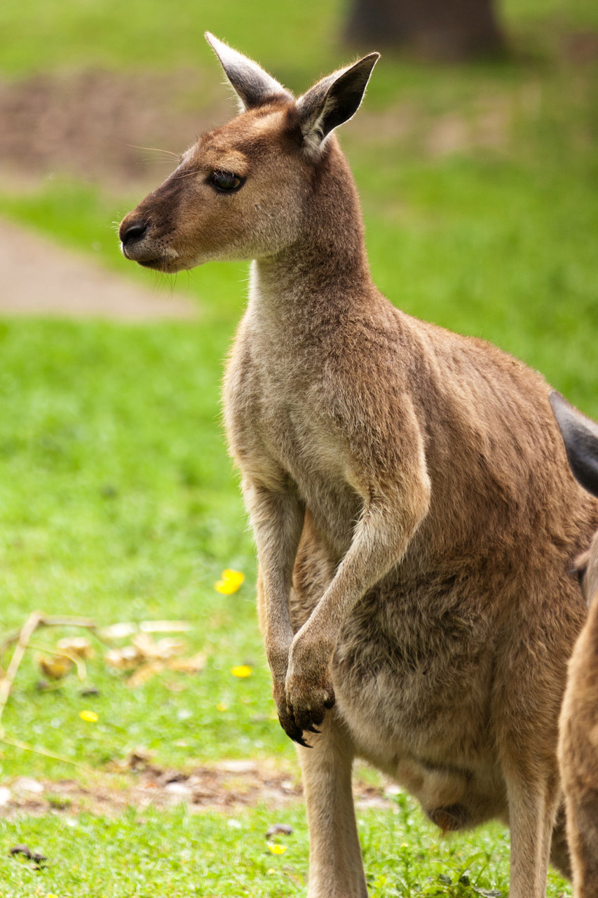
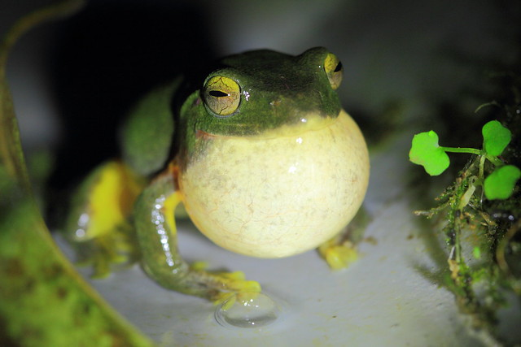
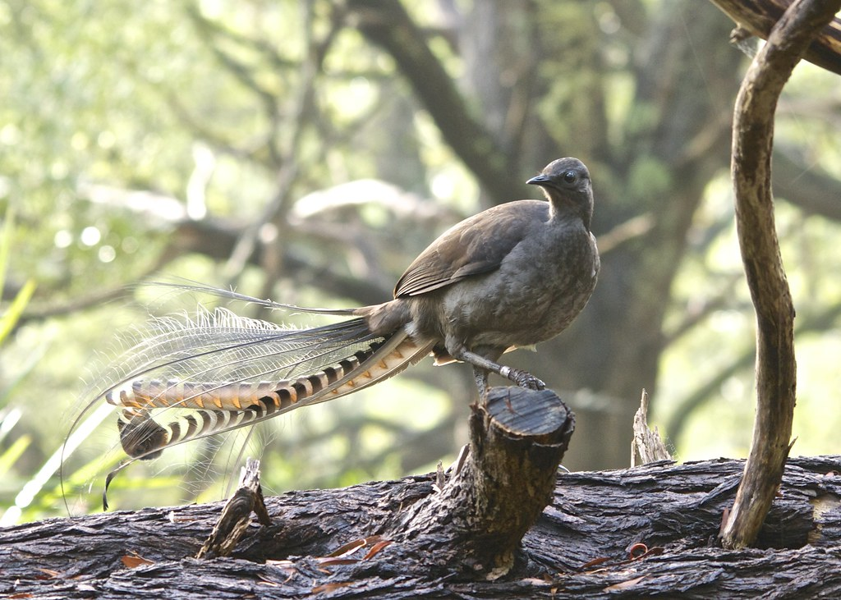
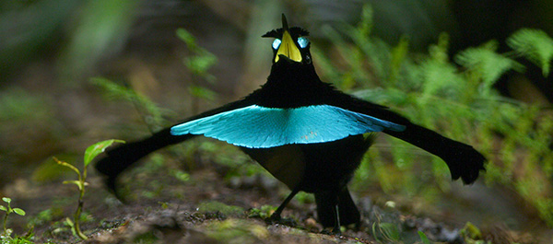
How do animals communicate?
Chemical
Electric
Tactile
MODALITIES
Acoustic
Visual
This Photo by Unknown Author is licensed under CC BY
Notes:
Animals communicate in many ways: some very different to the way humans communicate.
Modalities refer to the senses that are used in communication. Signals are sent from one animal to another via different kinds of modalities. The following are examples:
Chemical – Ants leave chemical trails that give directions to other ants. Lynx spray urine that contains pheromones to mark their territory, telling other Lynx where they are.
Electric – Weakly electric fish like this Peters’ Elephantnose Fish emit and detect small electrical signals in the water, which they are thought to communicate with, as well as electrolocate (like echolocation as bats do, but with electricity)
Acoustic – Human speech is “acoustic” communication, but many other species produce sounds to communicate: birds, frogs, insects, mammals. Here is a Superb Lyre Bird that mimics other sounds in the forest.
Tactile – Tactile communication requires touch, like shaking someone’s hand. Male kangaroos touch female kangaroos’ tails when they are asking to mate.
Visual – Many species use visual displays – bright colouring or body ornamentation – often for females to see how fit the males are. Birds of paradise are famous for bright feathers and courtship dances. Here the male displays his tail for the female.
ASK CLASS: What modality do they think gestures are in?

Slide 10
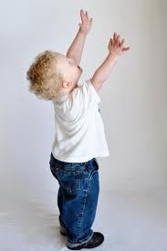
How do humans communicate?
Babies communicate without using words.
Are these signal language?
Notes:
Modalities refer to the senses that are used in communication. Humans use auditory and visual modalities to communicate.
Using these types of signals are different from using a spoken language, such as English. This is because a spoken language allows us to combine different signals and incorporates grammar. Linguistic signs are arbitrary and conventional (for example, different languages might use the same sound with different meanings). People use language intentionally, with the purpose of communicating, while at least some baby signals (for example, crying) seem more automatic, like reflexes.

Slide 11
Try communicating without words….
Notes:
Paired Activity – Try Communicating Without Words
PP Slide 11; Worksheet; Instruction commands (on separate sheet, to be cut up and distributed)
In this activity, children are being asked to give instructions to a partner without using words. The aim is for one partner to communicate to the other what they would like them to do with the cup, pen and paper. The key element is that they must not talk at all and find other ways to communicate their instructions.
Give out the worksheet: the children should record their findings on this.
Give a printed instruction to one of the partners in each pair. The instructor will then try to get their partner to do what is printed on the instruction.
Children should then complete the worksheet.

Slide 12
Did you manage to communicate?
How did you let your partner know what you wanted to happen?
How easy or difficult was this?
Language gives us a set of meanings for different signals (words or gestures) that everyone who knows that language understands.
Language allows you to combine signals in different ways to mean different things (for example, paper on the cup or cup on the paper). It has grammar.
This makes language a powerful way to communicate.
Notes:
This slide provides the opportunity for the children to report on the activity and think about how difficult or simple it was to communicate their instructions to their partner.
Our spoken language contains grammar, which is a set of rules covering how we make up sentences and clauses. It also relates to where the subject, verb and object usually appear in a sentence. Grammar is a crucial element of the above task, as the children would need to communicate what they wanted placed where: that is, which subject doing what on / in / below which object.

Slide 13
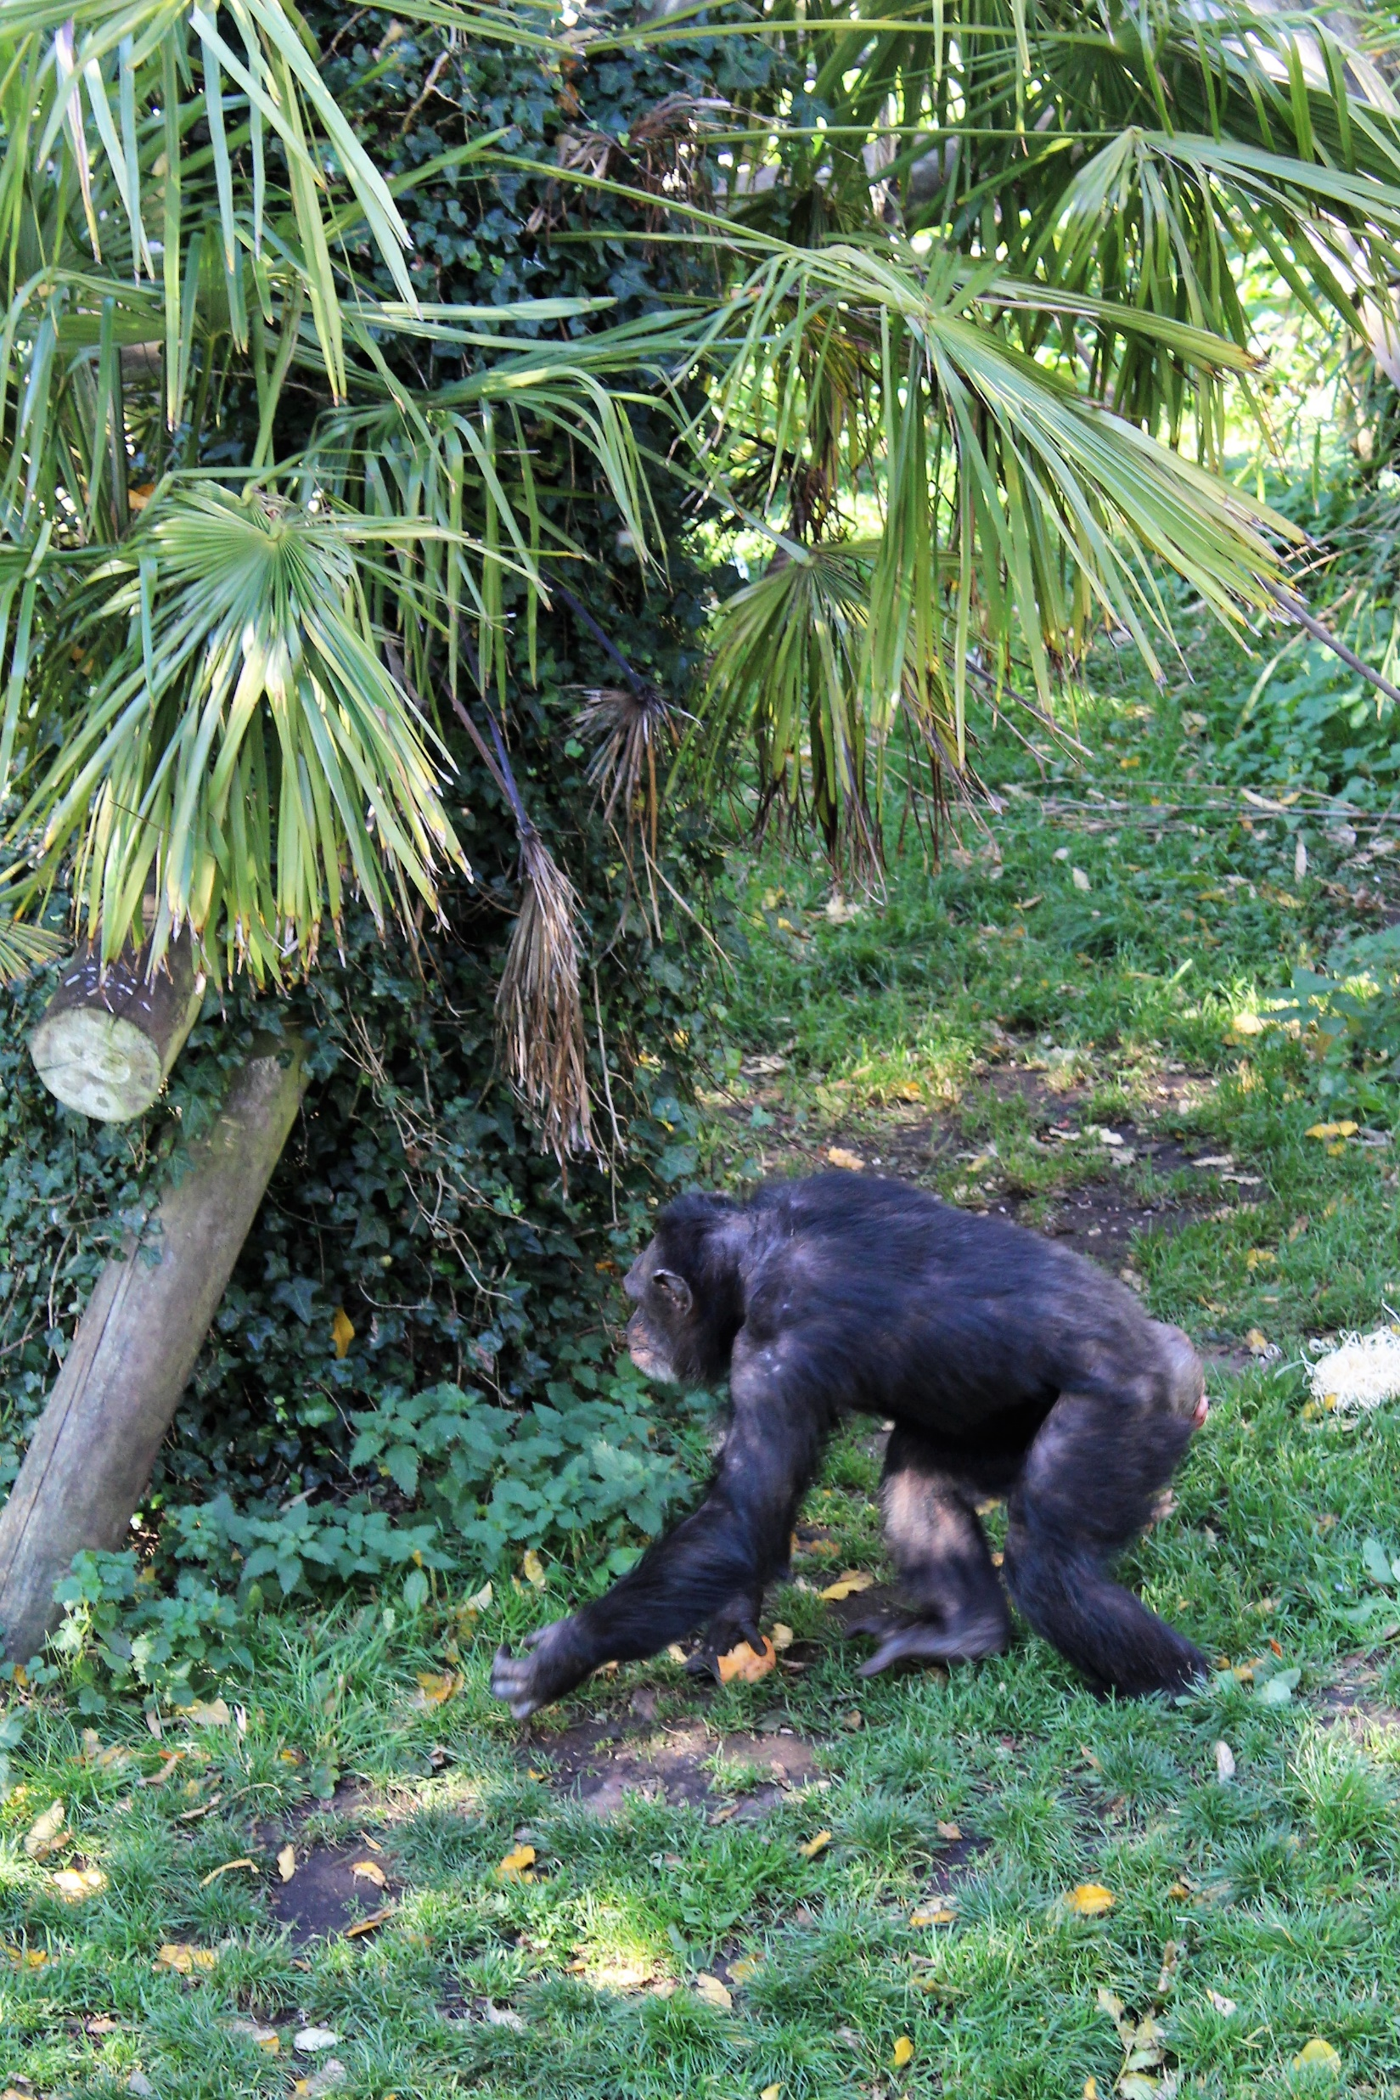
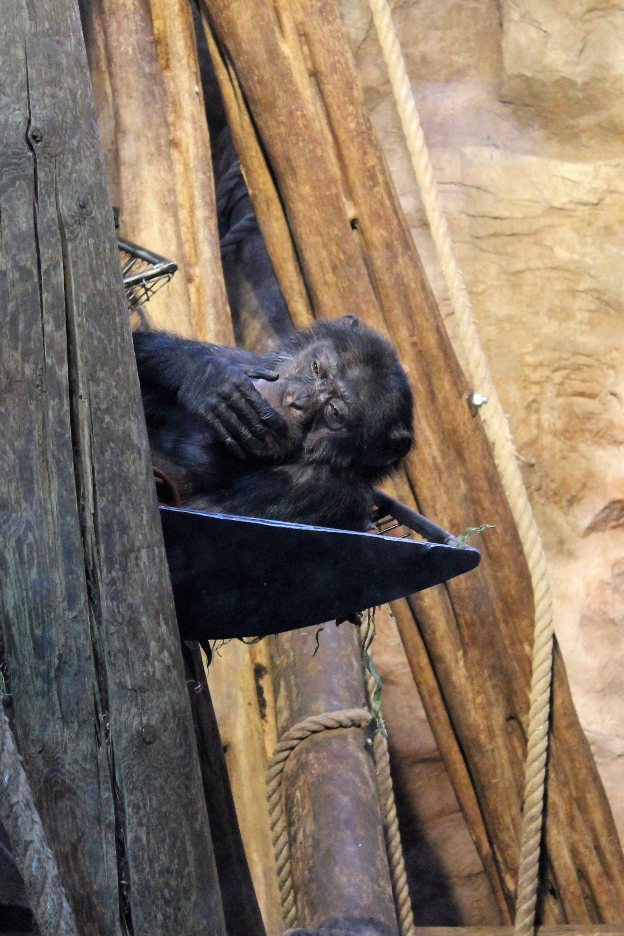
Is chimpanzee communication like language?
https://www.dropbox.com/sh/ae2l6f4wb6vusbr/AAC0Y4FYJNNc0zBi-efsc45la?dl=0&preview=Chimps.mp4
Notes:
These images are of chimps at Edinburgh Zoo.
Resources: PP Slide 13 with film; Worksheet Activity 2
This slide asks the children to consider whether chimp communication is similar to language.
Show the film and ask the children what they notice about the ways chimps communicate in the film. Ask them to think about whether the chimps can communicate what they want effectively.
Using the space on the worksheet, the children should record their thoughts, giving reasons for their ideas. Is chimpanzee communication like language? What is similar? What might be different?

Slide 14
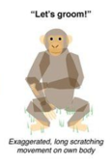
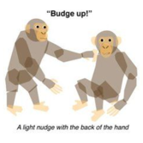
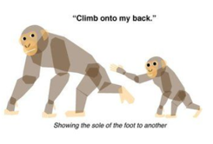
Is chimpanzee communication like language?
Language provides a set of meanings for different signals (words/gestures).
Everyone who knows that language will understand these.
Language allows you to combine signals in different ways to mean different things (it has grammar)
Researchers are trying to find out if chimpanzee communication has these features.
Notes:
This slide provide the opportunity to discuss the children’s ideas from their worksheets.

Slide 15
Make up your own chimp gestures!
How would you use your body to signal these messages to other chimps in your group?
Which gestures could be used to communicate the following?
I am your friend.
I don’t like that food.
I want to play.
I am tired.
Notes:
Paired Activity – PP Slide 15; Worksheet Activity 3
This activity is designed to allow the children to think about how they would communicate as chimps. They are asked to make up their own chimp gestures to convey messages as follows:
How would you use your body to signal these messages to other chimps in your group? Which gestures could be used to communicate the following?
I am your friend.
I don’t like that food.
I want to play.
I am tired.
They should then answer the reflective questions which follow, which are:
What is good about using gesture to communicate?
What is good about using language to communicate?
Which is more effective, do you think?

Slide 16
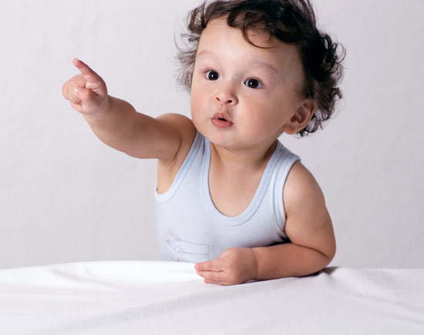
Today we thought about:
Is chimpanzee communication like language?
Look at that!
Notes:
PP Slide 16
Instructions: Recap the main points of lesson 4 as follows:
Today we thought about how chimpanzees are our closest living primate relatives. We thought about the similarities and difference in human and chimp hands, feet, faces and vocal apparatus. We then thought about what language is and whether chimps have a language in the way that humans understand this. We tried to communicate without using words. We watched a film about chimp communication and saw the gestures which they use and considered whether this was a language. We then made up our own chimp gestures and tried to use these to communicate different messages to each other.

