Slide 1
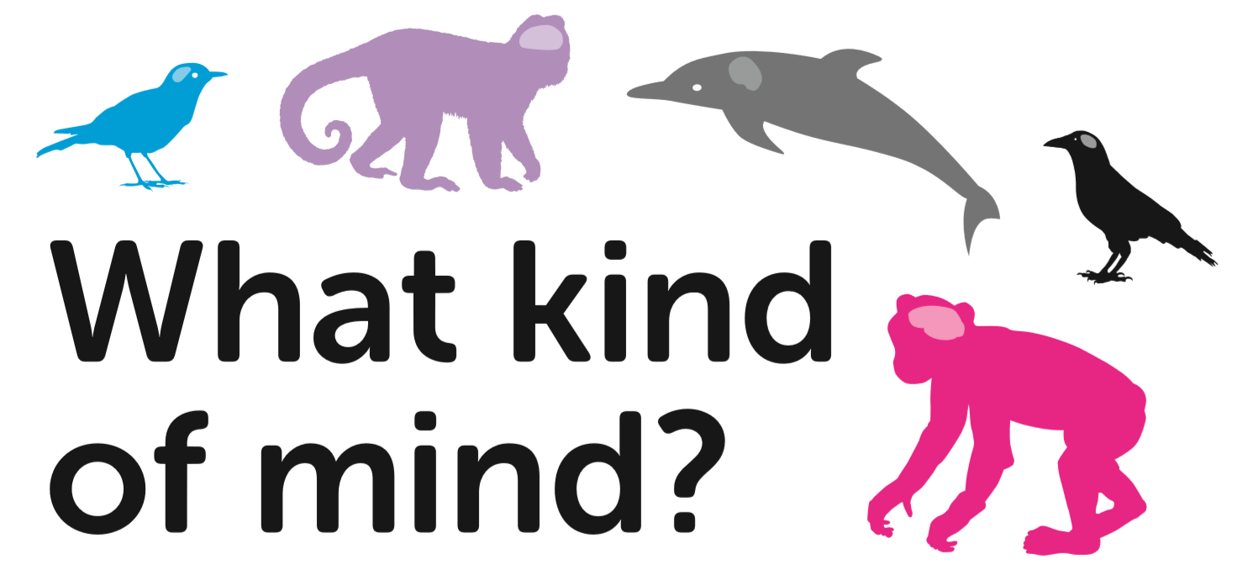
Lesson 2
School of Psychology and Neuroscience, and Department of Philosophy, University of St Andrews

Slide 2
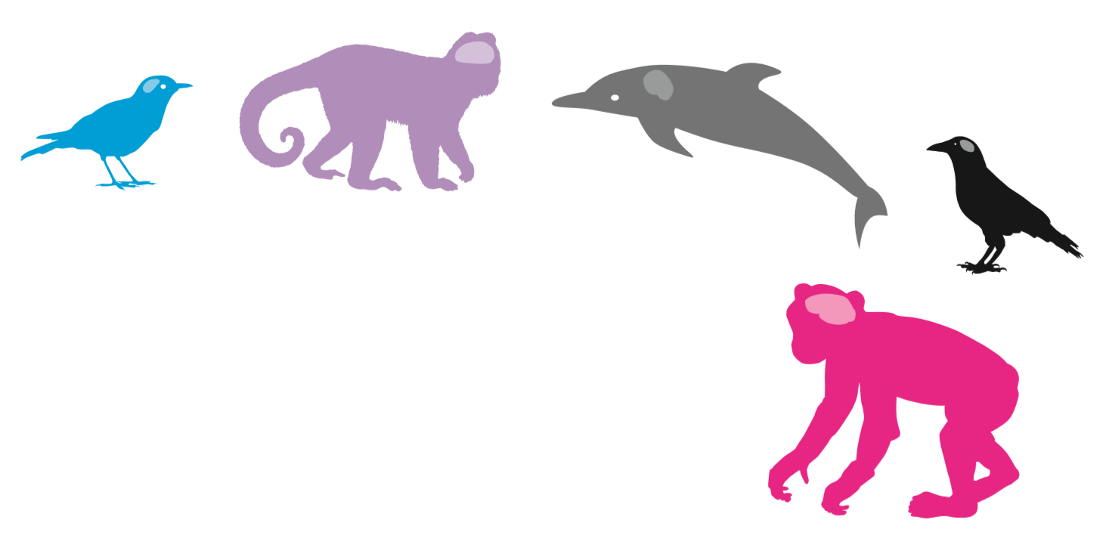
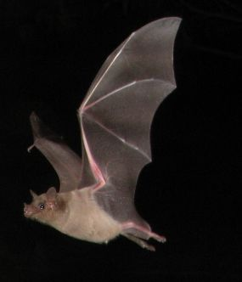
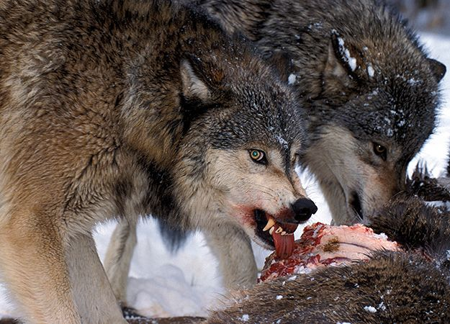
Last time we thought about:
Philosophy
Psychology
Notes:
This slide recaps the information from Lesson 1.

Slide 3
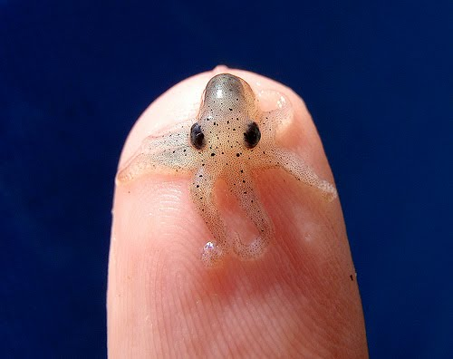
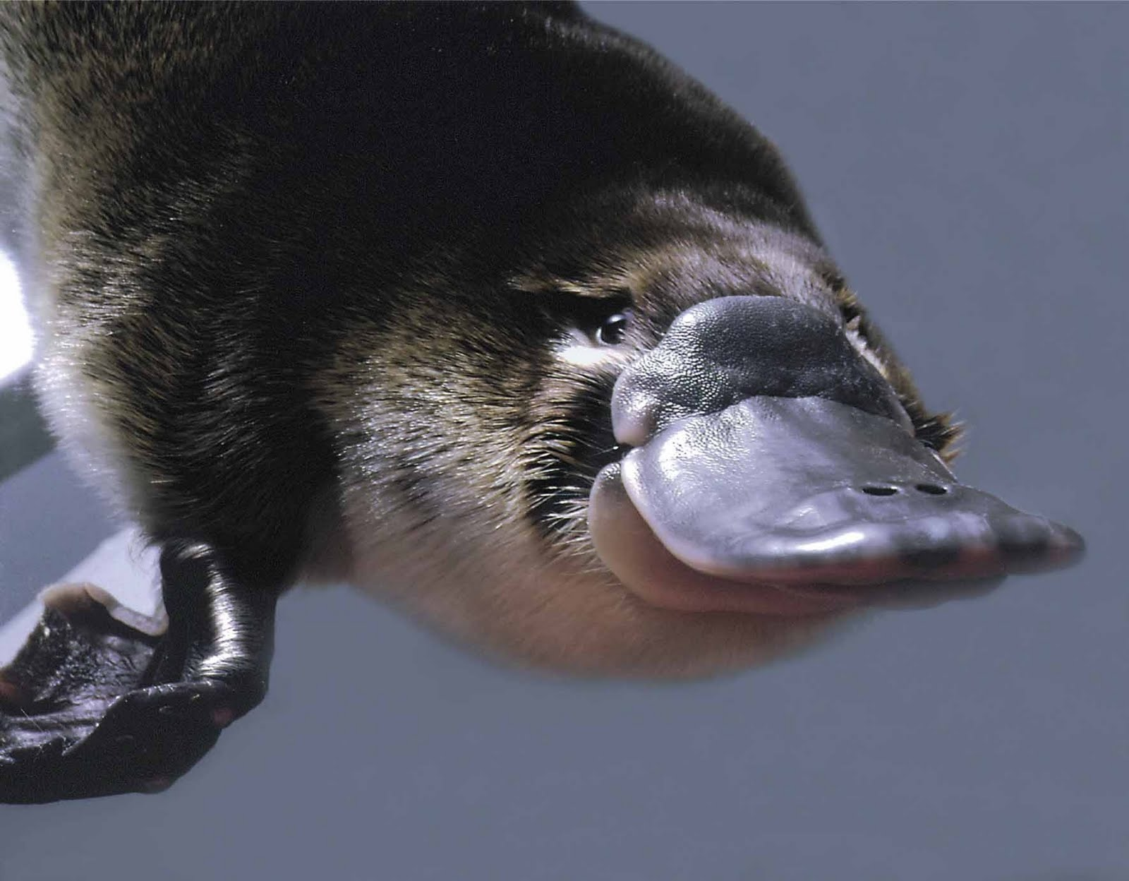
Why are there so many different sorts of animals?
Scientists think about why there are so many different species of animal on Earth.
The theory of evolution says that a very long time ago, all animals had a common ancestor.
Animals then adapted to their environments as they spread across the planet.
Those animals which survived were those best suited for the environments in which they lived.
Pygmy Squid
Platypus
This Photo by Unknown Author is licensed under CC BY-NC-ND
Notes:
This slide asks the children to consider why there are so many different species of animal on Earth. It sets the scene for the film about Charles Darwin and Evolution.

Slide 4
Notes:
This film explains the theory of evolution and natural selection.
This introduction to evolution builds upon the activity in the first lesson. The children have just been acting and thinking in creative ways as ‘bat scientists’. This has helped them to look at human beings in a novel and exciting way.
A real-life scientist who looked at life in a novel and creative way was Charles Darwin. His way of thinking about animals was revolutionary and changed how we think about life on earth. Show the film and invite comments from the children.
Humans are a distinct species of great ape family. We share many points of commonality with apes and other primates, such as monkeys. The animals we are today have evolved over millennia from primates, as a result of the process of natural selection. As this process repeats and continues, new species form. Humans developed as a result of selection in bipedalism and language, which allowed us to walk on two legs and to talk.
We only want to convey the very simple idea that (1) among any population, there is a range of characteristics (some group members are bigger than others, some differ slightly in colour, shape, etc.); (2) environmental conditions can make it the case that creatures with certain features are more likely to survive and reproduce; (3) over time, this can result in a change to the range of characteristics in the population (for example, if bigger, darker animals survive and reproduce, then eventually all of the animals will be big and dark). This is Darwin’s idea of “survival of the fittest”.

Slide 5
Which kind of beak is best?
Notes:
Give children ‘beakless’ finch template - ask them to draw the beak that could get grubs out from under tree bark.

Slide 6
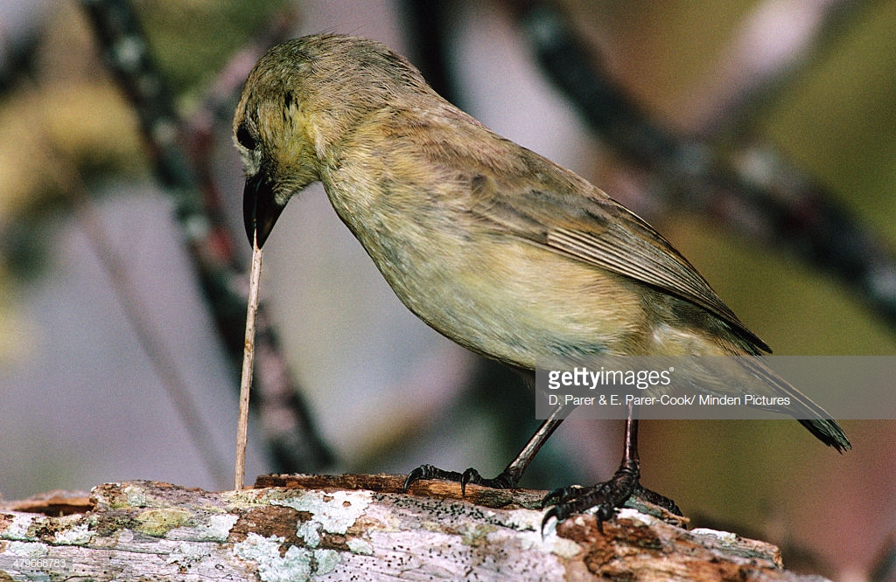
A woodpecker finch using a tool
https://www.arkive.org/woodpecker-finch/camarhynchus-pallidus/video-00.html
Notes:
Show the children film of the woodpecker finch – which uses a cactus spine as a tool! What did they think of the woodpecker finch’s behaviour? Can we say that the woodpecker finch is using a tool to get its food, much as we would use tools to help us get food (for example some humans use spears when hunting)? Does this mean that the woodpecker finch is intelligent?

Slide 7
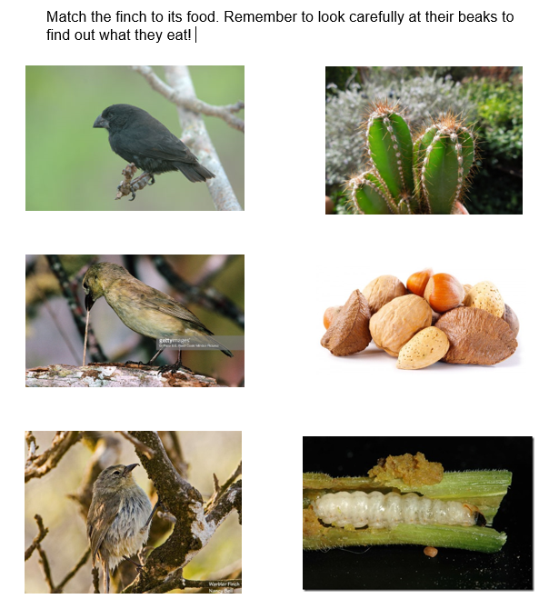
Match the Finch to the Food
Hard, strong beak
Cactus
Longer, thinner beak, perfect for holding sticks!
Nuts with hard shells
Sharp beak, which helps dig into fleshy plants
Maggots (which live inside trees)
Notes:
Invite the children to match the correct bird with its preferred food. How did you know which bird eats which food? What about the shape of the beaks helped you to match it with the food? Did you make a guess about which beak? How could you test your guess to see if it is correct?
Draw activity to a close by asking: Does this mean that the woodpecker finch is more intelligent than the other species of finches?

Slide 8
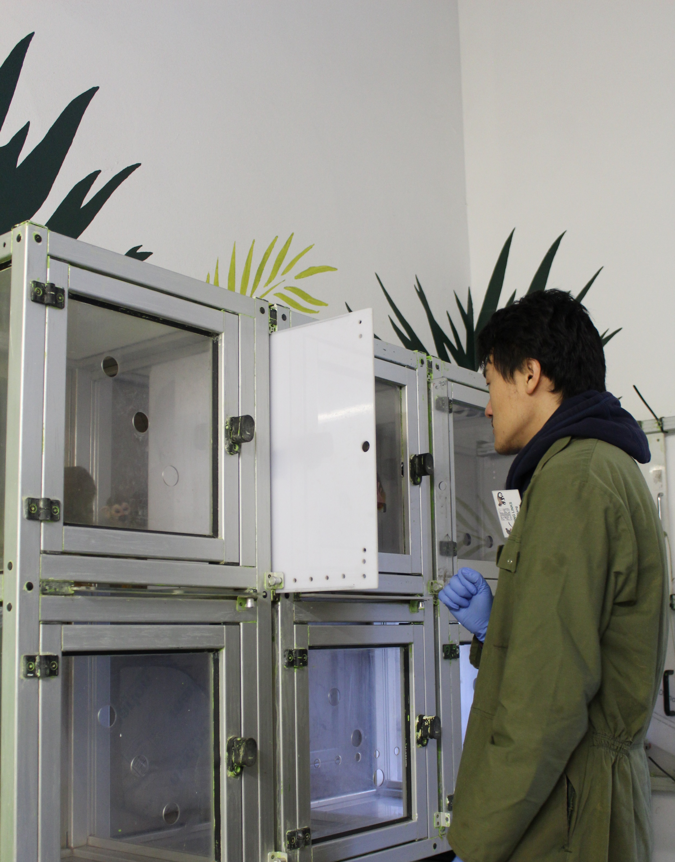
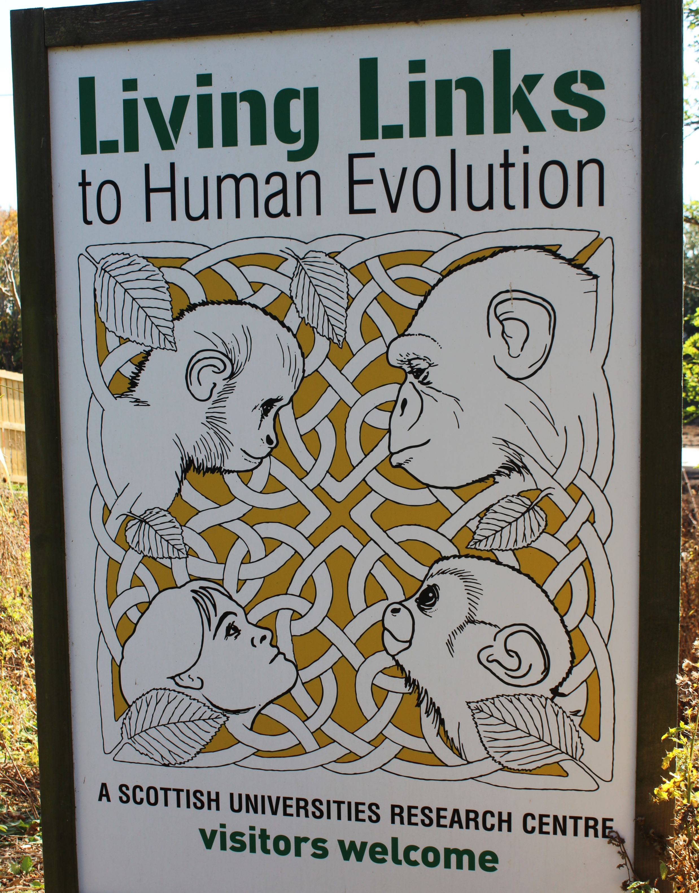
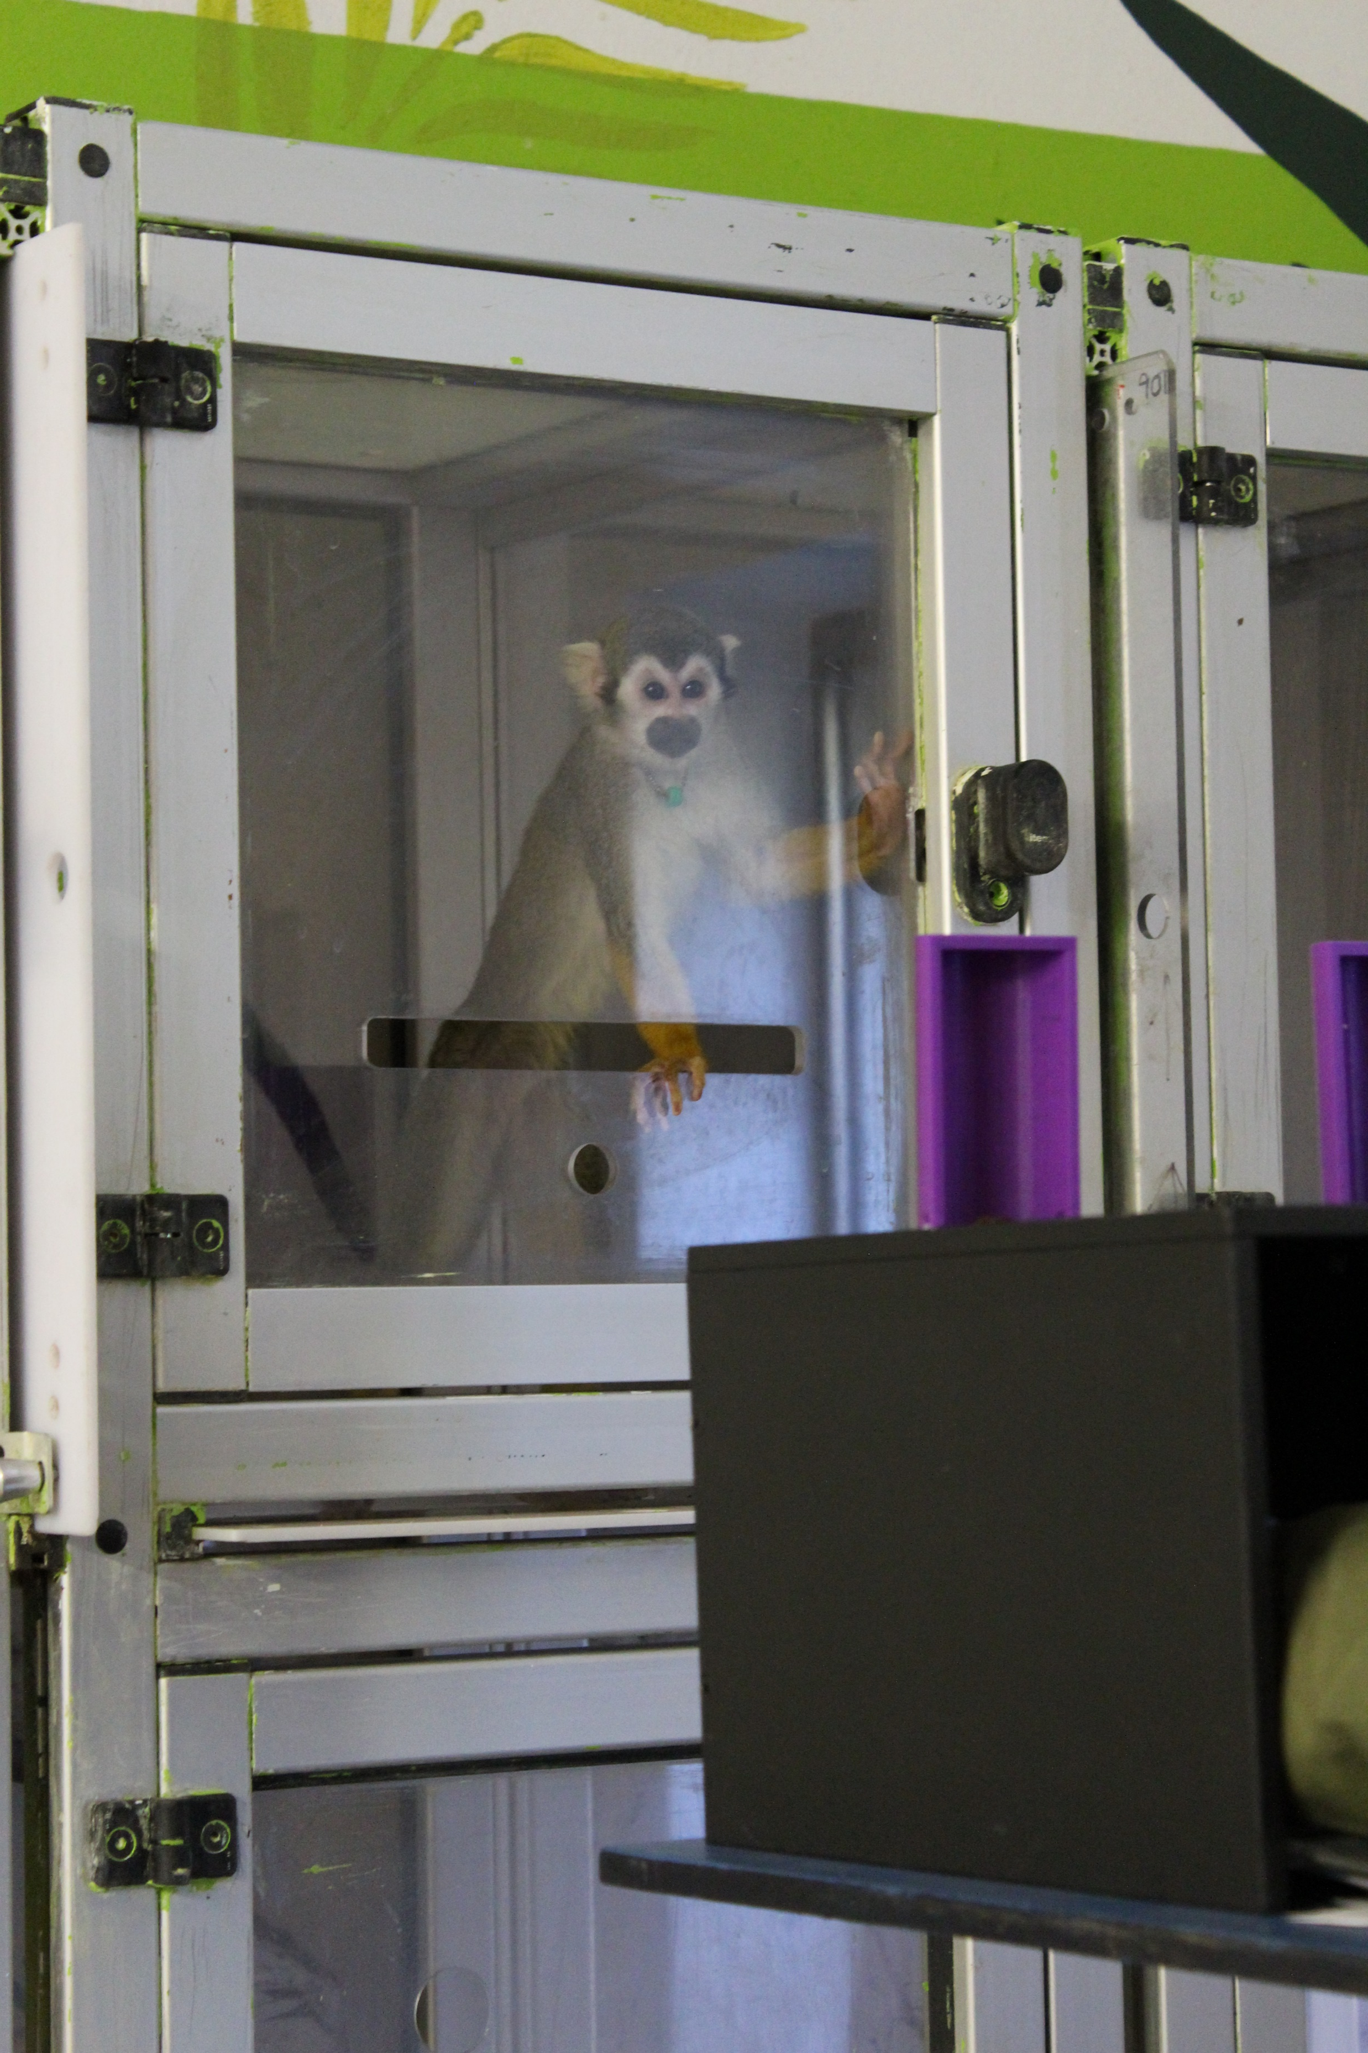
How do scientists carry out their research?
At Edinburgh Zoo, university scientists are researching the behaviour of monkeys.
Notes:
This slide shows a researcher at the Edinburgh Zoo Living Links Centre working with squirrel monkeys.
The monkeys are free to come into the research room if they wish and take part in the experiments. They volunteer and so they are not forced to do the research.
Visitors to the zoo can go and watch the research taking place.

Slide 9
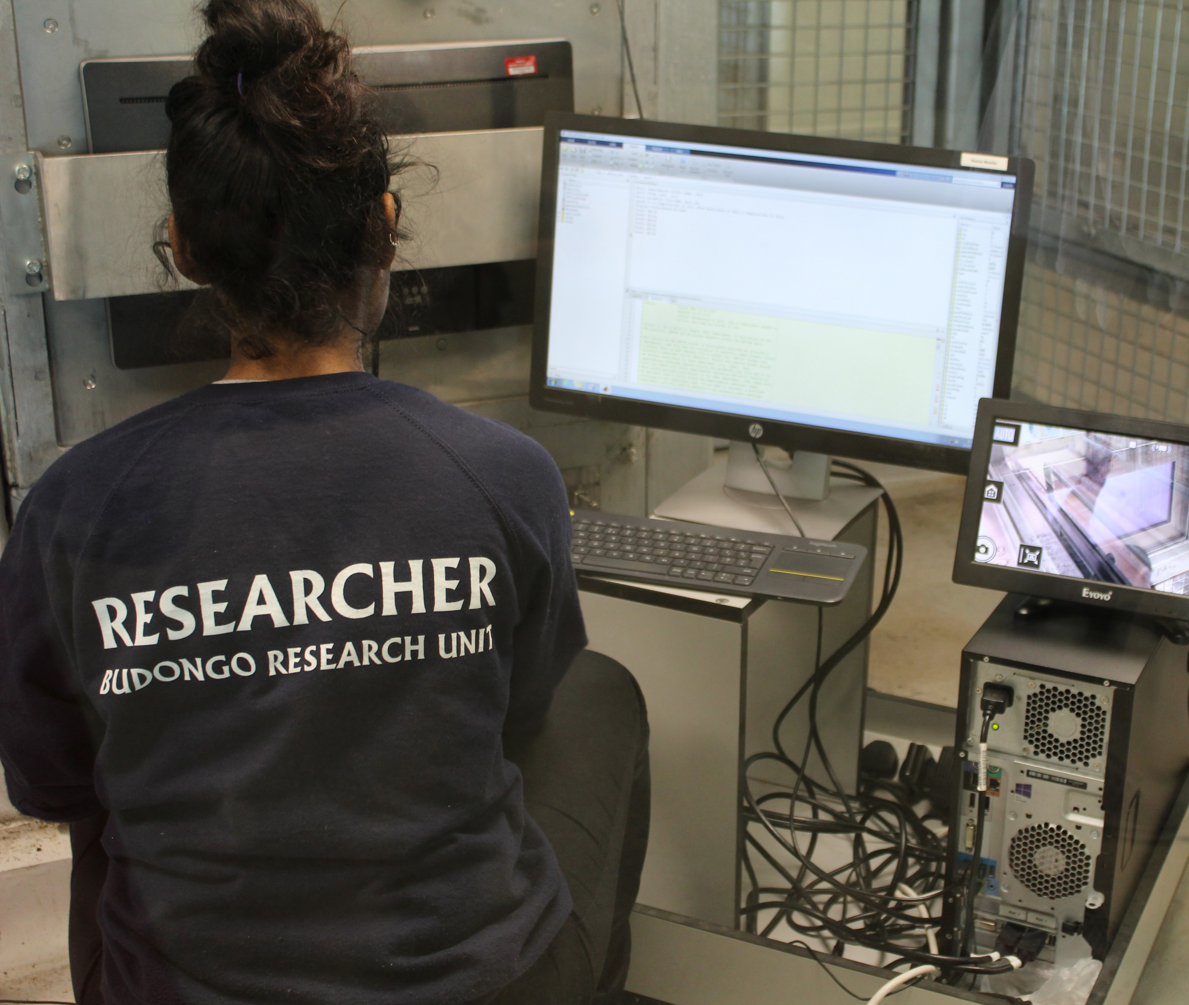
How do scientists carry out their research?
Scientists ask some questions about the area they want to investigate.
They make a prediction, called a hypothesis.
They design an experiment to test that hypothesis.
They carry out the experiment and look at the results.
They interpret the result to see if their prediction was correct.
Notes:
The slide introduces the idea of following the scientific method. The scientific method is repeated throughout the presentation and the experiments are mapped onto this model in the following slide.

Slide 10
The Scientific Method
Question
Hypothesis
Experiment
Results
Interpretation
What do you want to know?
The claim that you are trying to test
The way you are testing the claim
What did you find?
What can you conclude? Was the hypothesis supported, or not?
REMEMBER: Your hypothesis should make a definite prediction about the experiment!
Notes:
This task introduces scientific method and demonstrates the various stages that a researcher will go through to test an idea. The scientific method is the ordered way that scientists will carry out research and try to find answers to their questions. All scientists follow this process when setting out to test their ideas. The order of the steps in the scientific method is important for reliability and allows the research to be replicated if required. The idea that one type of finch may be more intelligent than another is then applied to the scientific method as an illustration.
Explain that this is the way that scientists will research and try to find answers to their questions. All scientists follow this process when setting out to test their ideas. Notice the different parts of the method and the order in which they are carried out. It is important to follow this same order to ensure that the scientific tests are trustworthy and the results reliable. Following the exact order is important and necessary if the tests need to be repeated at a later date. A hypothesis is a kind of educated guess, or a good prediction, which will then be tested to see if it does explain the scientific idea.
Ask the children: How can we find out if one finch is clever than the others? Can we compare finches by giving them tests to do? What would the tests be like? Can the finches choose the right tool?
We’ve included a slide that describes the scientific method in an abstract way. Many groups will be quite familiar with this; for those that aren’t, here are some things to stress. Our basic goal is to try to investigate some question, and in order to do that we are going to try to test a particular claim that bears on that question. The claim we are testing is called the hypothesis. We want to devise a test -- an experiment -- and we want to use the hypothesis to make a definite prediction about what will happen in the experimental scenario. If that prediction turns out to be true, that is some evidence for the hypothesis; if the prediction turns out to be false, that is some evidence against the hypothesis. However, the situation is often complicated: perhaps there is some other explanation of why we got the results we did. So we need to interpret the results.
In the next slide, we include a detailed example.

Slide 11
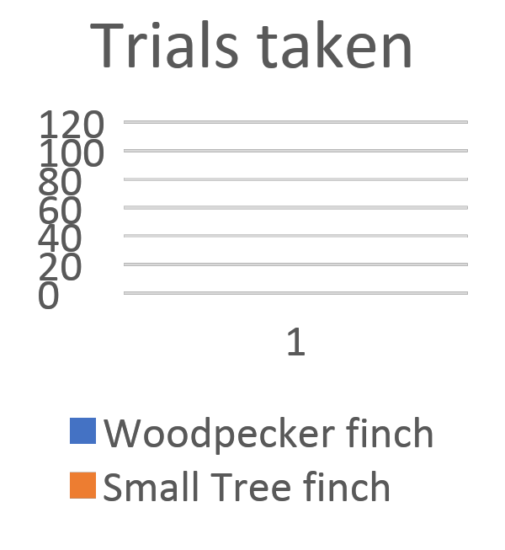
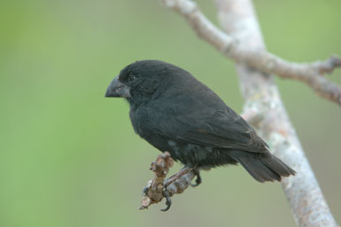
The Scientific Method: Flexible Finches?
Question
Hypothesis
Experiment
Results
Interpretation
Hypthesis
Did tool-using finches evolve to be more intelligent?
Tool using finches will perform better on physical intelligence tests
Hypothesis not supported!
Both species of finch could learn to solve the task about equally well
Cane task
Notes:
Some finches use tools, others don’t. The experiment was designed to investigate the question of whether there is something special about the minds of the finches that use tools. Have they evolved a new kind of intelligence? Or are non-tool-using finches equally intelligent (suggesting that all the finches evolved from an intelligent ancestor)? The finches were presented with a transparent box, through which they could see two curved canes and two pieces of food, arranged in one of the ways depicted in the slide. (In the drawing on the slide, the round dots represent the pieces of food.) They could retrieve the food only by pulling on the canes. The birds had to choose which cane to pull; one would deliver the food, and the other would not. An intelligent creature should be able to learn to choose the correct cane.
If tool-using finches are more intelligent, we would expect them to do better on this kind of test; that is our hypothesis. More specifically, the hypothesis predicts that tool-using finches will learn to choose the correct cane more quickly. But this prediction turns out to be wrong: non-tool-using finches learned equally quickly. So, we have some evidence against the hypothesis.
We can see how the experiment maps on to the scientific method in this slide. Result of study = all finches can learn and choose tools equally well. The hypothesis that woodpecker finches will perform better is not confirmed. One conclusion we might want to draw is that the ancestor finch was a good learner and passed this ability on to all of its descendants.

Slide 12
Today we thought about:
Notes:
This slide recaps the information from today’s lesson.

