Slide 1
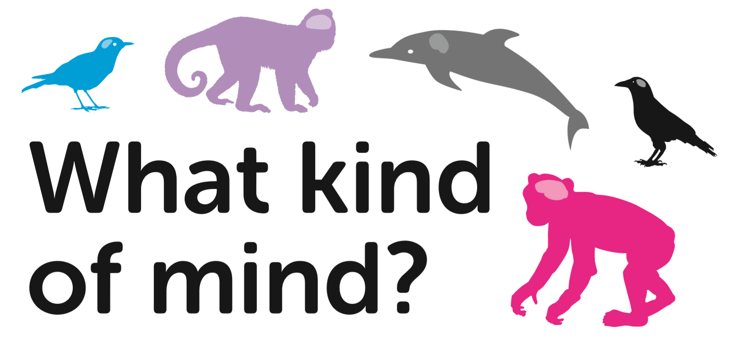
Lesson 1
School of Psychology and Neuroscience, and Department of Philosophy, University of St Andrews

Slide 2
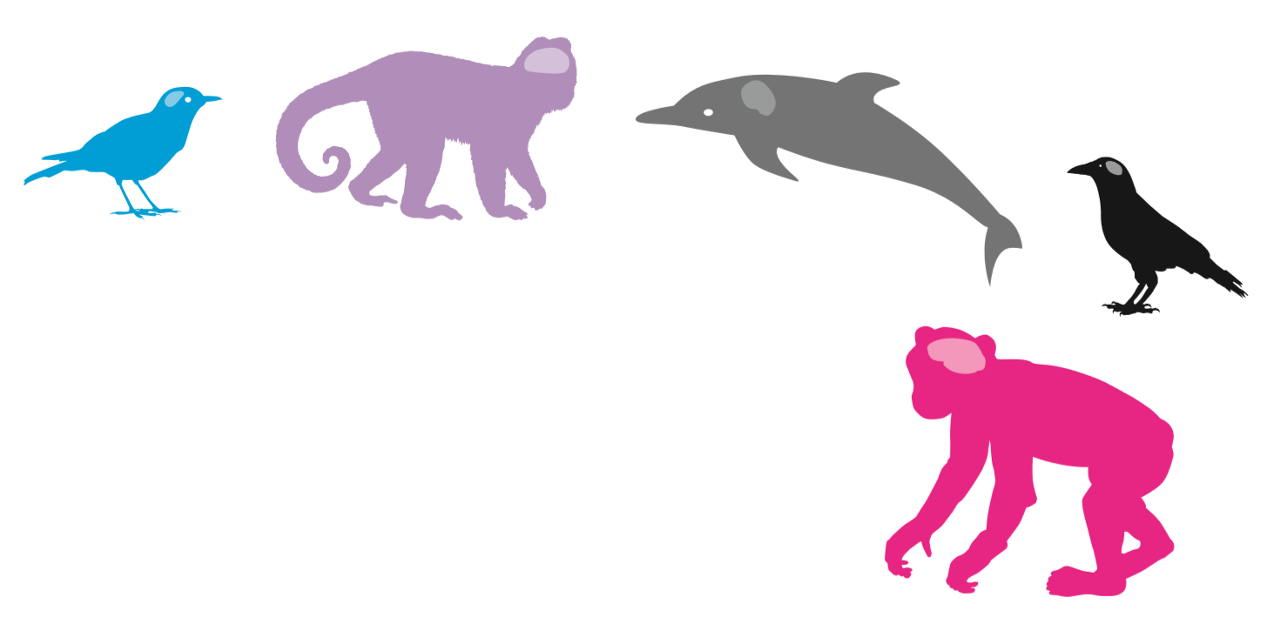
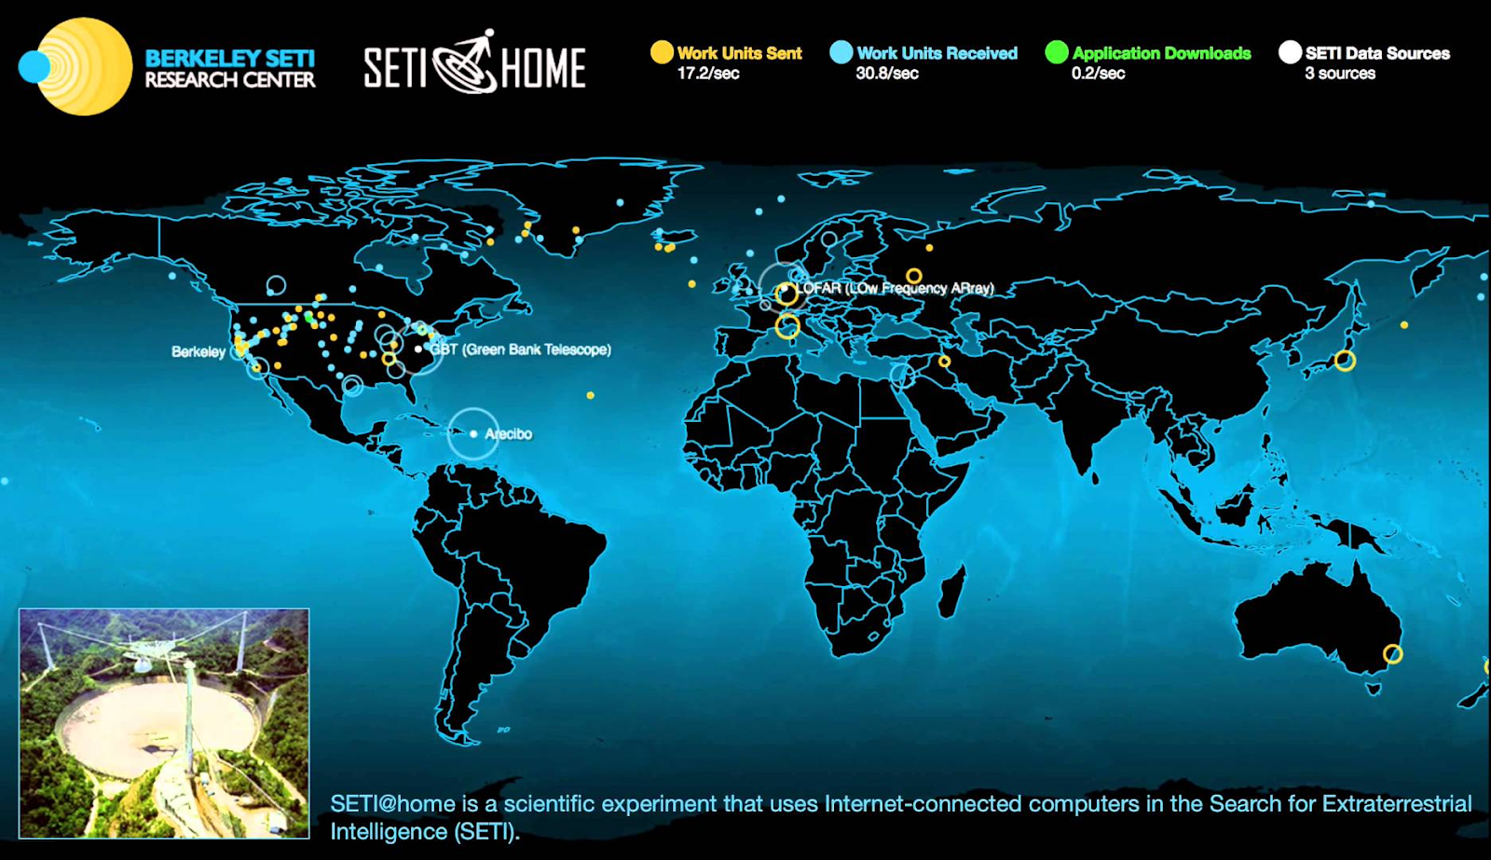
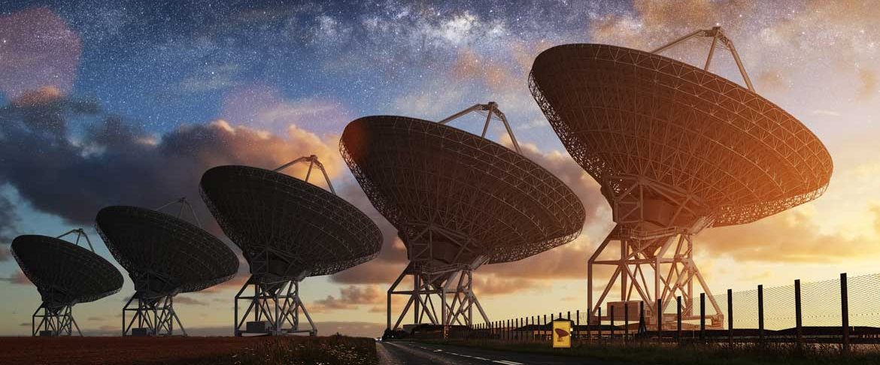
Life on other planets?
SETI - Search for Extra-Terrestrial Intelligence
Scientists use very powerful telescopes to look for life on other planets.
Notes:
This is meant to be a general class discussion, just to stimulate interest in the topic. You can use slides 2 and 3 to kick off the discussion. Some pupils may have heard of SETI -- the Search for Extra-Terrestrial Intelligence. SETI analyses data from powerful radio telescopes for signs of intelligent life on other planets. This is a very interesting project!

Slide 3
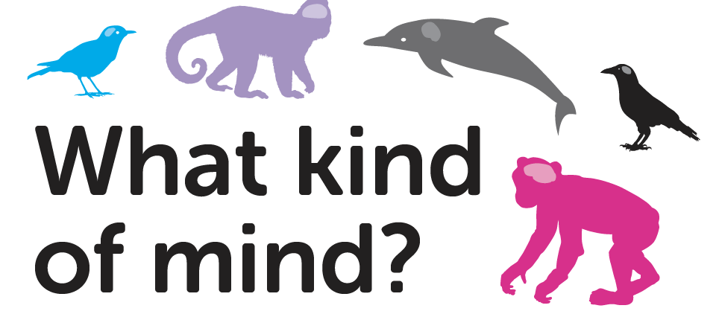
Notes:
But there is intelligent life much closer to home. We can search for, and try to understand, Terrestrial intelligence: the minds of animals right here on Earth. Animals engage in many of the kinds of activities that have traditionally been thought of as distinctive of human intelligence, including using tools and sophisticated social interactions, including communication that shares many features with human languages.
The photos depict a dolphin (carrying a sponge that it will use as a tool to protect its snout during feeding), orangutans (socialising with each other -- pupils may want to discuss their social intelligence, or their emotional lives), and a New Caledonian crow (carrying a tool that it will use to retrieve food).

Slide 4
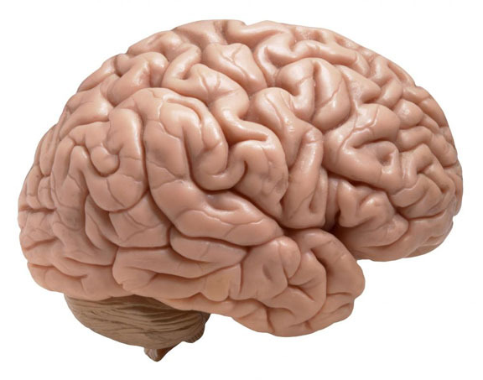
Psychology
Animal Minds
Philosophy
Psychologists and philosophers work together to investigate whether animals may have minds like us.
Animals have brains which look similar to ours, but that does not mean that they think in the same ways that we do.
By learning about animal minds, we can learn about our minds too.
Human brain
Notes:
Slides 4, 5 and 6 introduce the work of the research team and give background on their disciplines.

Slide 5
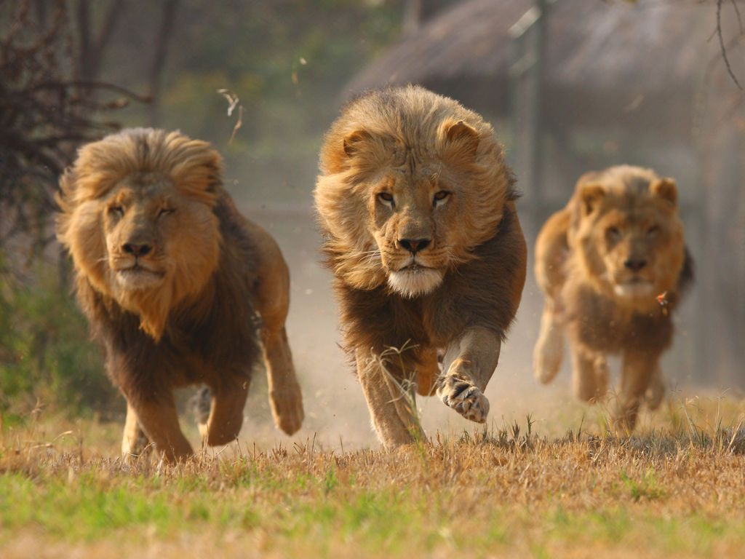
Psychology
Psychology is the study of minds and how they work.
Psychologists try to understand and explain behaviour.
They want to know how and why an organism acts in the way it does.
Psychology uses scientific methods to search for patterns in the behaviour of humans and other animals.
By finding patterns, psychologists try to predict behaviours and find out how these might be because of our brains and hormones

Slide 6
Philosophy is the study of the big questions in life.
What is a mind?
Do we have free will?
How can we know something for certain?
Which actions are morally right and which are morally wrong?
Philosophers search for the truth by using good reasoning and thinking.
Philosophy helps us to understand our place in the universe.
Philosophy
‘To be surprised, to wonder, is to begin to understand.’
Jose Ortega y Gasset

Slide 7
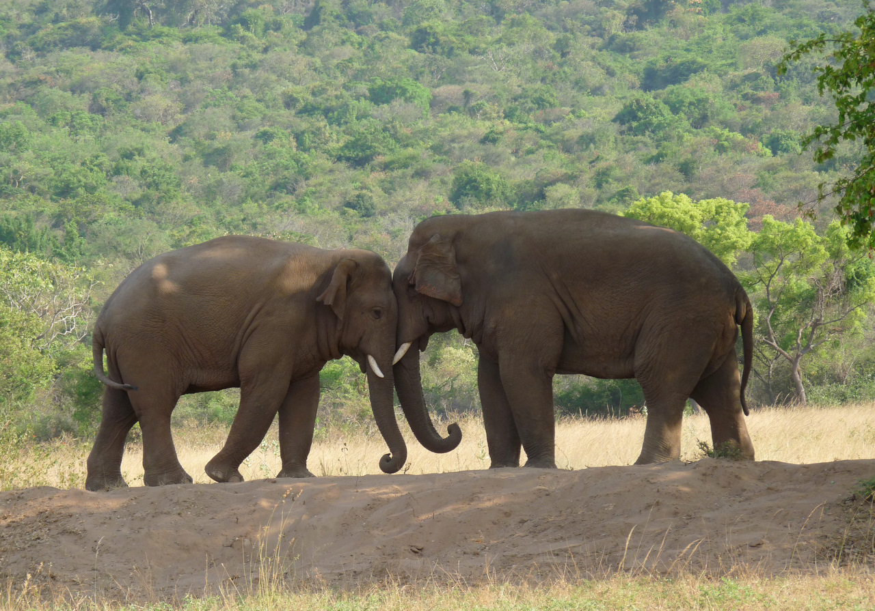
How can we tell if something is intelligent?
What sorts of things show that something is intelligent?
Is it that they can learn?
Is it that they are social and live in groups?
Is it that they can find food?
Is it that they can react to something?
Is it something else?
Notes:
These questions help to stimulate discussion for the small group activity and reinforce the idea that we need to give reasons for our claims about intelligence.
The crucial questions to be asking are: why do we think that some are cleverer than others? What is our evidence? What do these things do that tells us how clever they are? Some possible considerations that pupils might invoke include: the ability to learn (as opposed to responding automatically), reacting to the world, brain size, having a goal, maybe other things like emotion, creativity, biological similarity to humans. In the end, there is no one right answer; there may be many interesting notions of intelligence or ways things might be intelligent. Some students may also raise considerations that might make us sceptical that a creature is intelligent: perhaps its behaviour is just a reflex or instinct, something automatic and not intelligent. These considerations should also be encouraged: in many cases, it is very difficult to tell whether a particular behaviour is intelligent or not, and even experts may disagree. There are different ways of thinking about what intelligence is because there may be different notions of intelligence. One animal might be more intelligent than another in one way, but less intelligent in a different way. This all suggests that we should be thinking carefully about the question of intelligence.

Slide 8
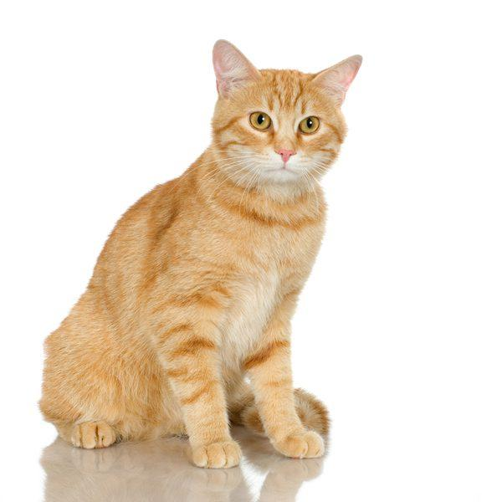
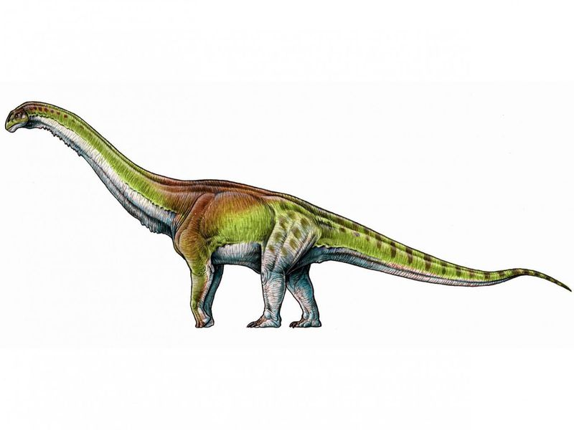
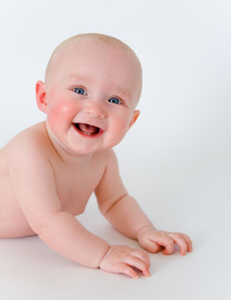
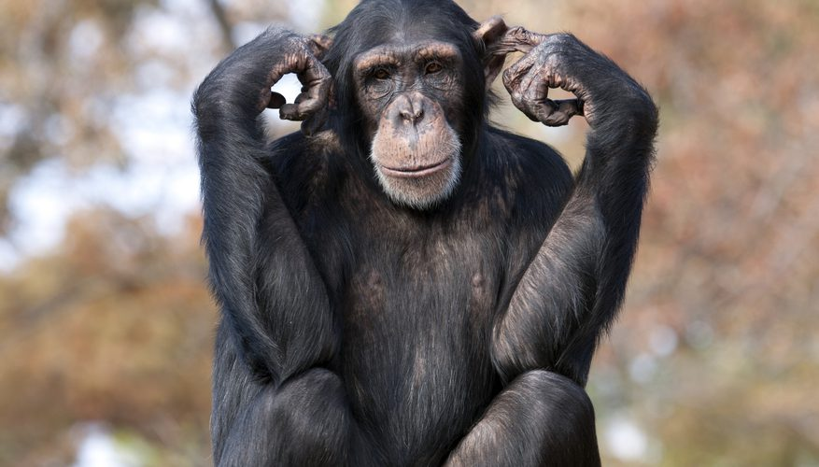
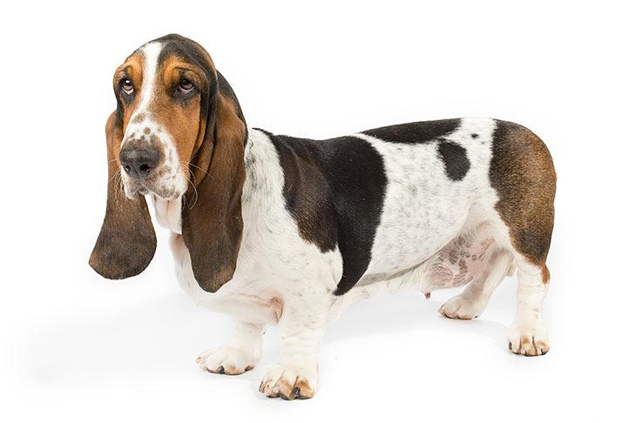
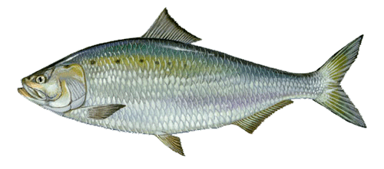
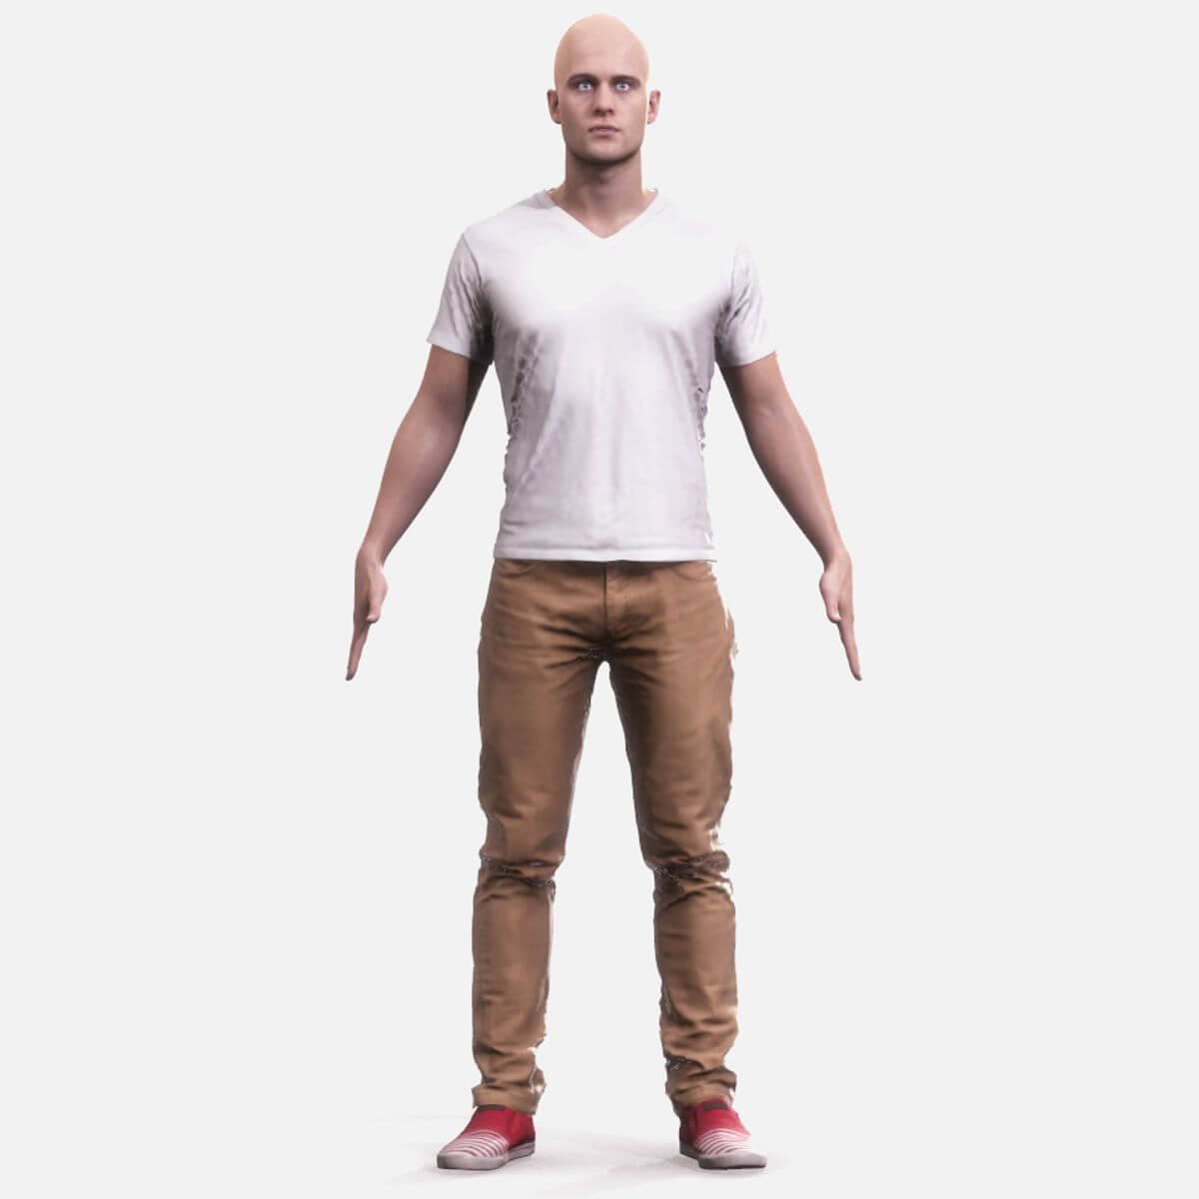
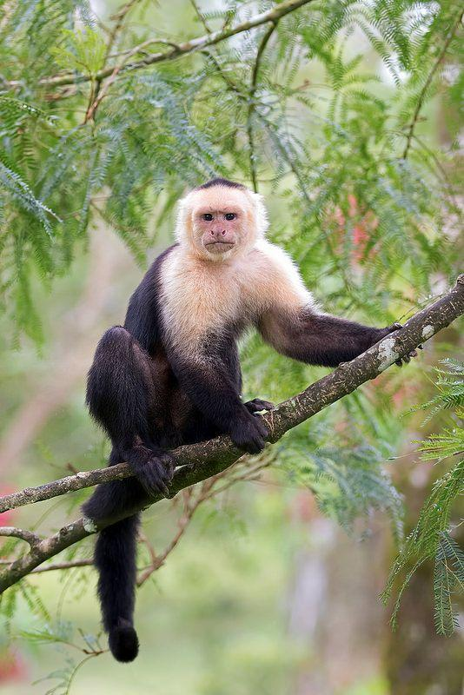
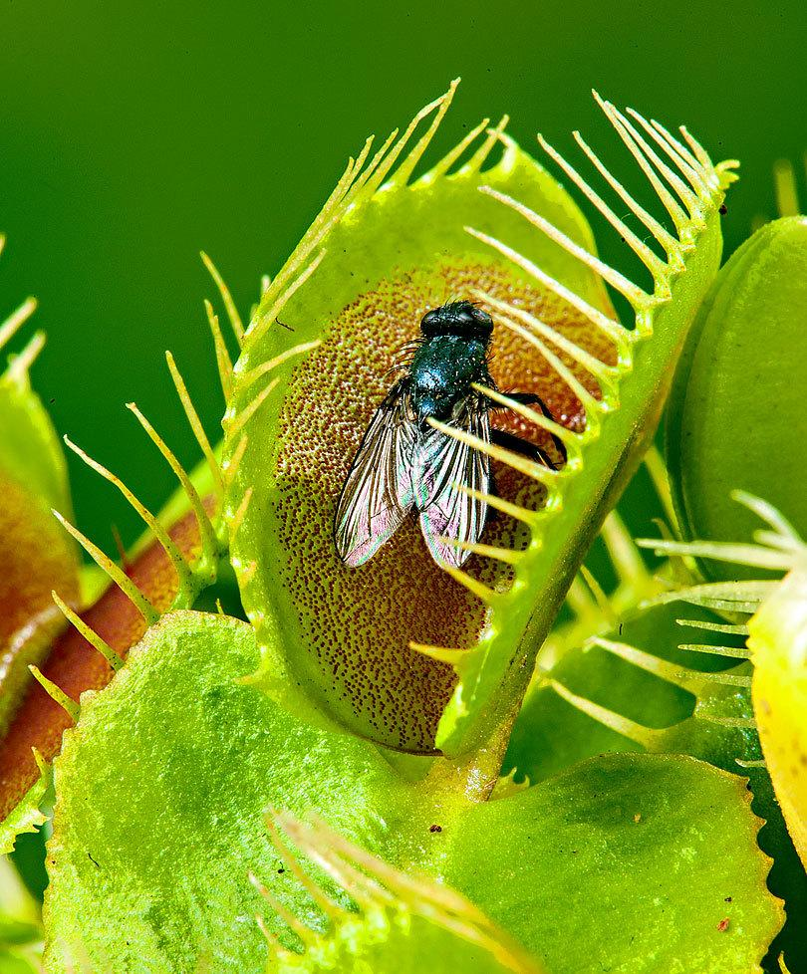
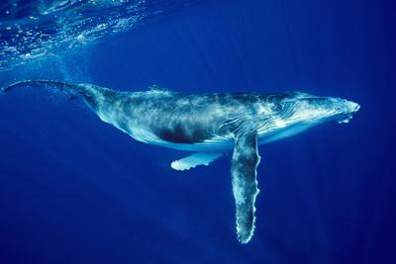
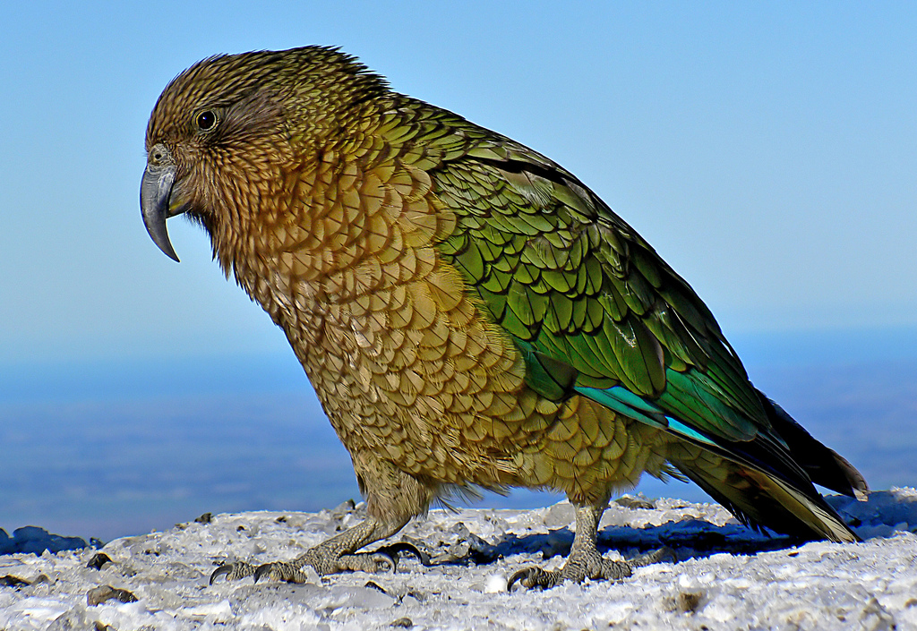
How Intelligent Are These Things?
Move the animals, plants, and objects across the scale on to indicate how intelligent you think they are.
Not Intelligent Very Intelligent
Notes:
This is the image of the poster and cards for the small group activity.

Slide 9
How can we tell if something is intelligent?
Which things did you decide were intelligent?
How did you decide if they were intelligent?
There are different ways of thinking about what intelligence is.
One animal might be more intelligent than another in one way, but less intelligent in a different way.
Researchers study intelligence in all sorts of ways
Notes:
This slide is used to round off the activity with a whole class discussion and comparison of reasons for their choices. There are different ways of thinking about what intelligence is because there may be different notions of intelligence. One animal might be more intelligent than another in one way, but less intelligent in a different way. This all suggests that we should be thinking carefully about the question of intelligence.

Slide 10
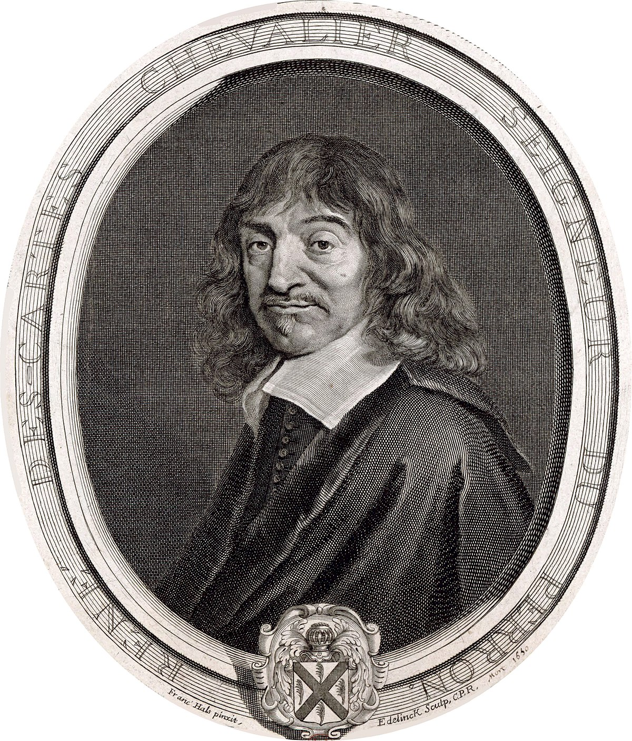
?
What is a mind?
The 17th century philosopher René Descartes thought that the mind was a soul or spirit, completely distinct from the body.
Notes:
These slides are meant to encourage discussion about what actually IS a mind.
There is a long history of philosophical debate about the relationship between the mind and the body. The PowerPoint slides are designed to introduce some key ideas in a simple way. See ‘A Brief Guide to Philosophy of Mind for Teachers’ for more information.

Slide 11
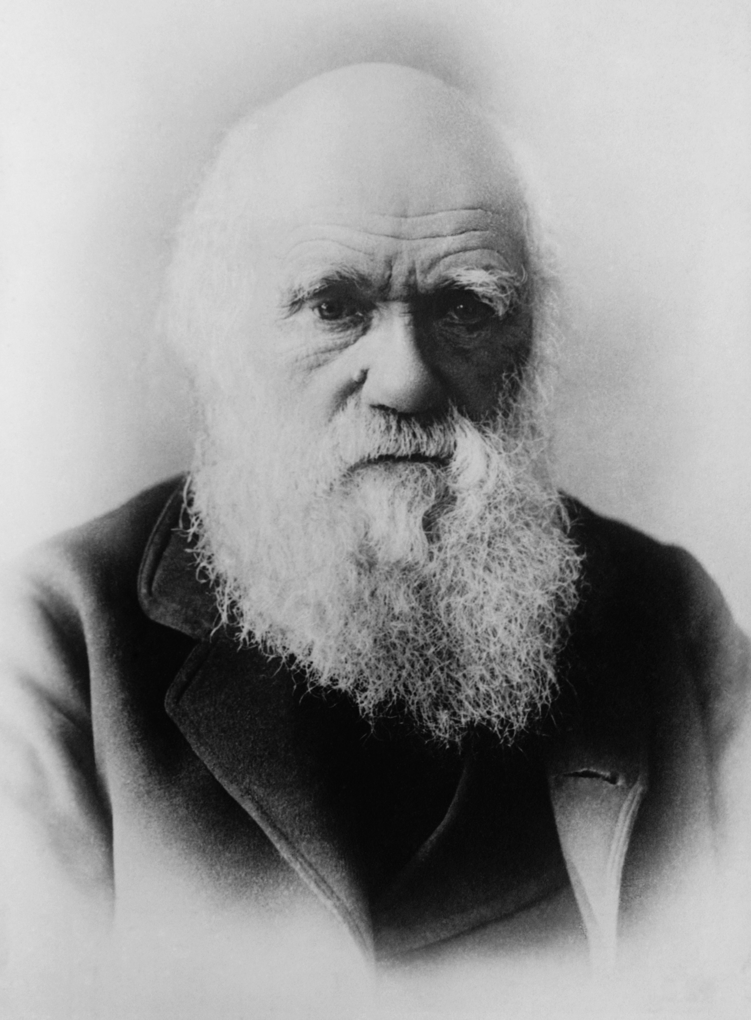
What is a mind?
The 19th century biologist Charles Darwin thought that the mind was just the activity of the brain.
He thought that there was no fundamental difference between human and animal minds: we could study the evolution of mind just like we study the evolution of bodies.

Slide 12
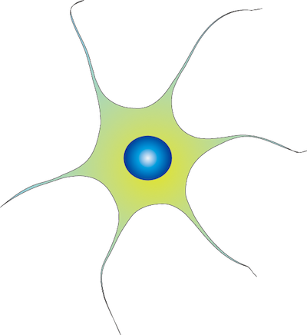
If the mind is the brain, what features of the brain matter?
The way the brain makes you act in response to your environment?
Biological features, like having certain kinds of nerve cells?
The way the brain processes information?
Notes:
This slide continues the discussion about how we can know the mind.

Slide 13
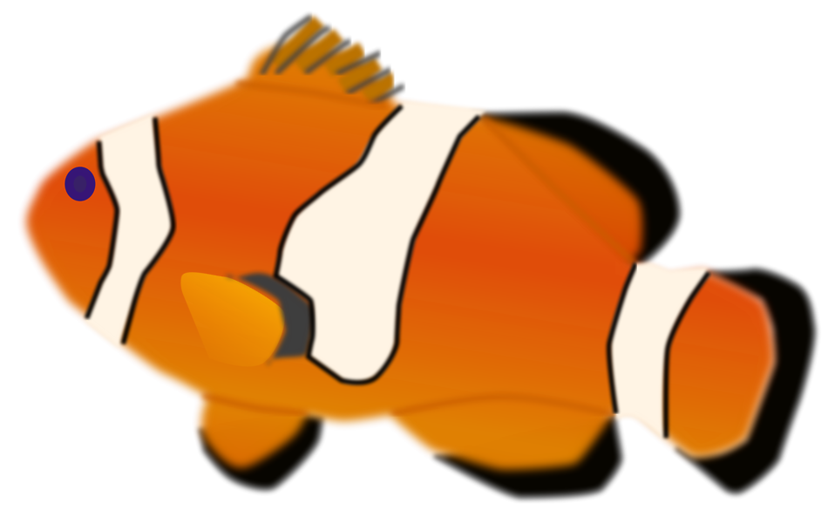
But biologically they are very different from us.
Can fish think?
Fish search for food and flee from danger in their environment.
A computer might process information just like our brain does.
Could a computer be intelligent?

Slide 14
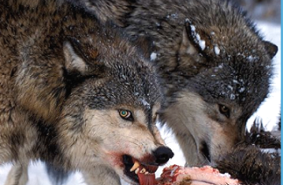
Animal Behaviour
How does this animal look to you?
Notes:
The following slides show that scientists must be careful when observing animal behaviour. They must not assume animals feel a certain way, just because their behaviour looks similar to human behaviour.
The slides ask children to consider how the wolf is feeling or what it may be thinking in this picture. The slides demonstrate that it is difficult to know this for certain. They are self-explanatory and show that the wolf may look angry, when it is in fact merely hungry.
Scientists must not assume animals feel a certain way, just because their behaviour looks similar to human behaviour. Avoiding presumptions like this is important when designing experiments about animal behaviour.

Slide 15
Animal Behaviour
An animal may look angry...

Slide 16
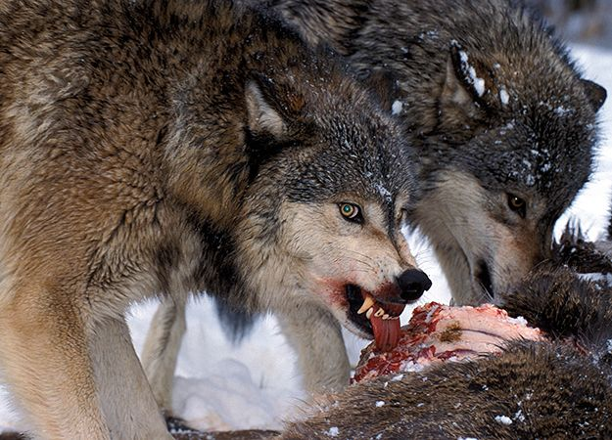
Animal Behaviour
…when it is just hungry!

Slide 17
Animal Behaviour
So when we are designing experiments with animals:
We must not assume that animals feel a certain way, just because their behaviour looks similar to human behaviour.
We need to know more about how their minds work.
Or we could make the mistake of thinking that all animals think and behave in the same ways we do!

Slide 18
Animal Behaviour
Being in dark, enclosed spaces makes many humans feel uneasy.

Slide 19
Animal Behaviour
Rodents, like mice and rats, feel most comfortable in these environments.
Wild rats live in burrows and tunnels, so dark, enclosed spaces are a place of safety from predators.

Slide 20
Animal Behaviour
Imagine an experiment testing how well humans and rats can find their way to the end of a maze
A HUMAN may require a WELL-LIT environment to feel comfortable.
A RAT may need a DARKER environment to feel comfortable.

Slide 21
Notes:
This film shows bat behaviour.

Slide 22
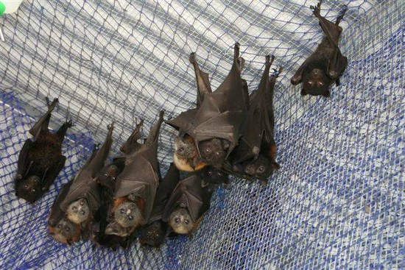
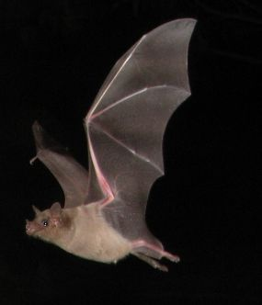
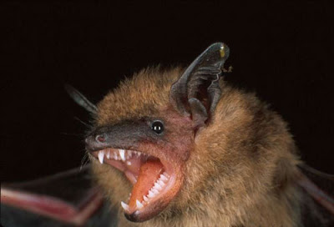
Batty about bats!
Notes:
This slide serves as a prompt to ask the children what they remember or like about the bats’ behaviour.

Slide 23
Be a Bat Scientist!
Notes:
This activity encourages children to think creatively about animals: specifically, the human animal. They are asked to pretend to be bats, in particular to be ‘bat scientists’ and think about how bats would go about studying humans.
Read the short story of bats working out what it means to be a human below (Cave, 2012, p.319) and have a human subjective experience. Ask the kids to think about how the bat scientists would work out how humans think about the world. What would these bat scientists want to know about humans? How would they find out about how we make friends or play games, for example?
Instructions: Read out short passage from philosopher Peter Cave:
Bat Scientists:
How to think like a bat…or how far science may go
From high in the chapel’s rafters, we look down on you humans and wonder, ‘What is it like to be a human being?’ We can try walking on two legs. We may attempt to sleep on beds – oh for a lovely rafter – but that would only tell us what it is like to be a bat pretending to be a human. You humans lack our echolocation faculty. Your experiences must be most limited and utterly bizarre. We could investigate your brains and see how you respond, but we should still miss out on how you humans experience the world.
Reference: Cave, P. (2012) How to Outwit Aristotle: and 34 Other Really Interesting Uses of Philosophy, London, Quercus.
The question “What it is like to be a bat?” was famously discussed by the philosopher Thomas Nagel. Nagel wanted to draw attention to the bat’s subjective experience. When a bat flies through the air using echolocation, it is in a particular kind of sensory or perceptual state. It must feel a certain way to the bat to use echolocation; but it is very hard (arguably impossible) for us to imagine it. (A similar point can be raised by thinking about a person blind since birth trying to imagine what it is like to see.)
Is there any way we could know what it is like to be a bat? We can learn about the bat’s brain; but it isn’t clear that this will help. We could try to act like a bat, but arguably that won’t help either; that might tell us what it is like for a human to do the things a bat does, but it doesn’t seem to tell us what it is like for the bat.
In 1790 an Italian scientist, Lazzaro Spallanzani, determined that bats were using their ears to navigate in the darkness, by setting up experiments that isolated the bats ability to see, smell, and hear. But Nagel suggested that science may not be able to answer questions like “what is it like to be a bat?” Pupils may want to discuss whether this is correct.

Slide 24
Be a bat!
Notes:
This activity allows children to think about what it may be like to be a bat, using sound to negotiate movement in the room. Bat in centre – circle of pupils – one person to make ‘beep’ noises and the ‘bat’ goes towards the noise.
What did it feel like to use sound (instructions) to navigate? Did it feel like seeing? What might it feel like to be a bat?

Slide 25
Today we thought about:
Philosophy
Psychology
Notes:
This slide recaps the information from the lesson.

